Slide 1



Update of the 2024 Guiidelines for Lower Limb Peripheral Artery Disease
Yann Gouëffic, MD, PhD
Department of vascular and endovascular surgery, Groupe Hospitalier Paris Saint Joseph, Paris, France.
Notes:
Guidelines
We want to extend the endo ttt
Surgery has a low co morbidity rates
Endo has a lower co morbidity rates
However assessment was based on TASC and TASC mix the CTO (most challenging lesions) with stenosis
CTO good tk success
CTO with covered stent

Slide 2
Disclosures
Y. Gouëffic reports:
Research funding from General Electric, WL Gore, Bentley, Boston Sc
Personal fees and grants from Abbott, BD, Bentley, Boston Scientific, Cook, General Electric, Medtronic, Penumbra, Shockwave, Teleflex, Terumo, WL Gore (medical advisory board, educational course, speaking)

Slide 3
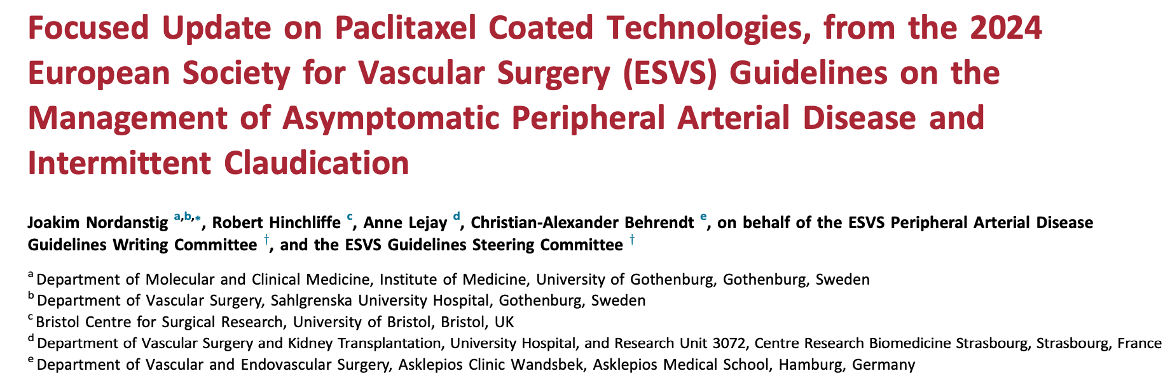
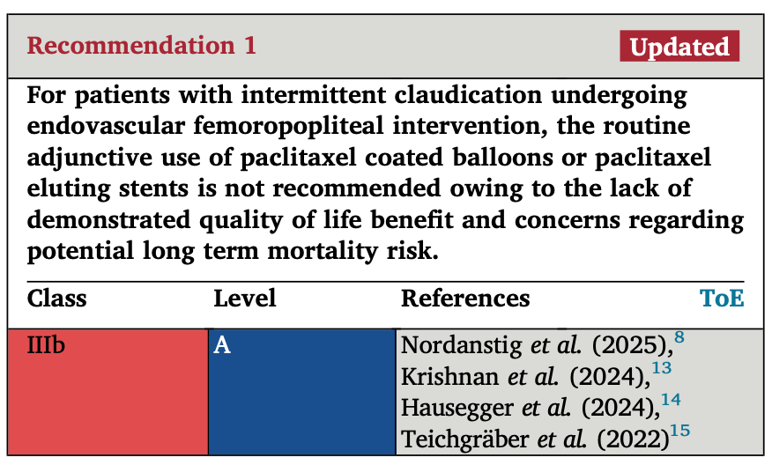
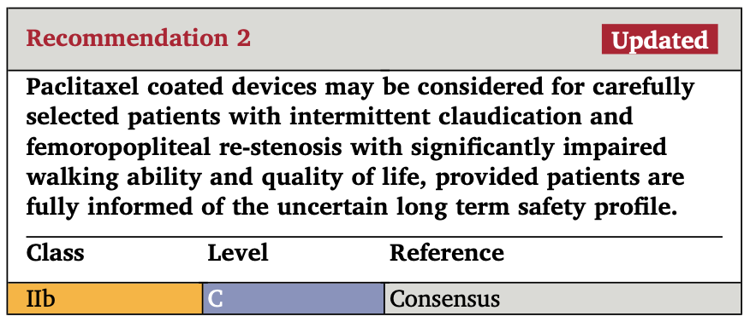
Nordanstig, Eur J Vasc Endovasc Surg, 2026

Slide 4
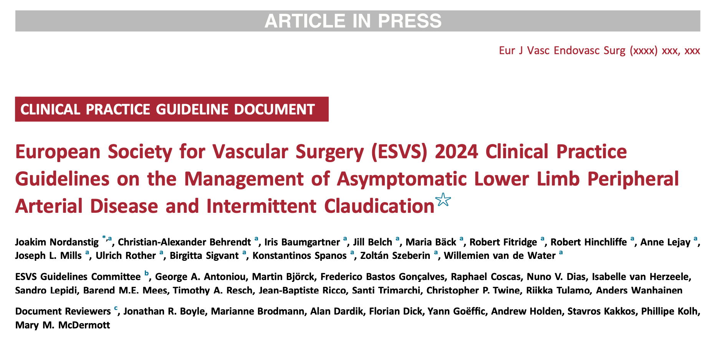
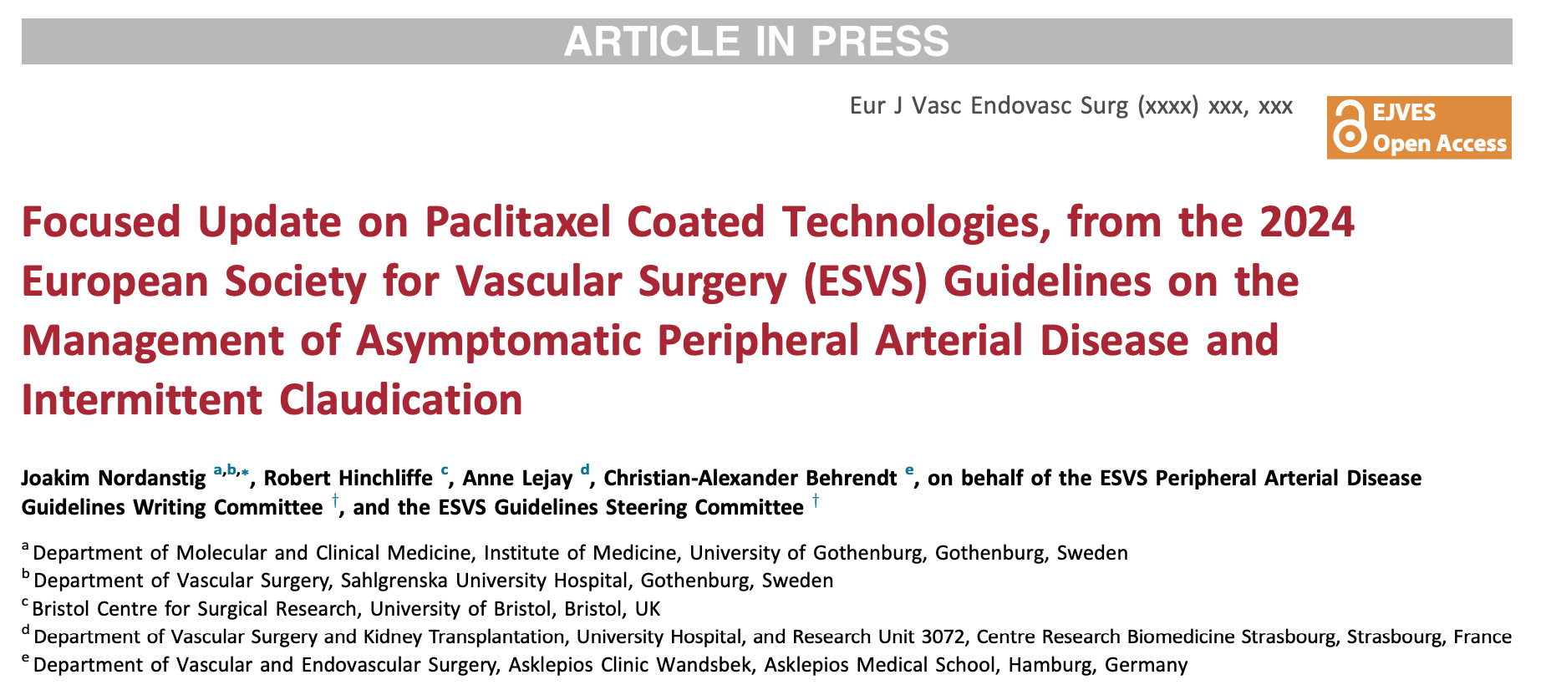

Slide 5
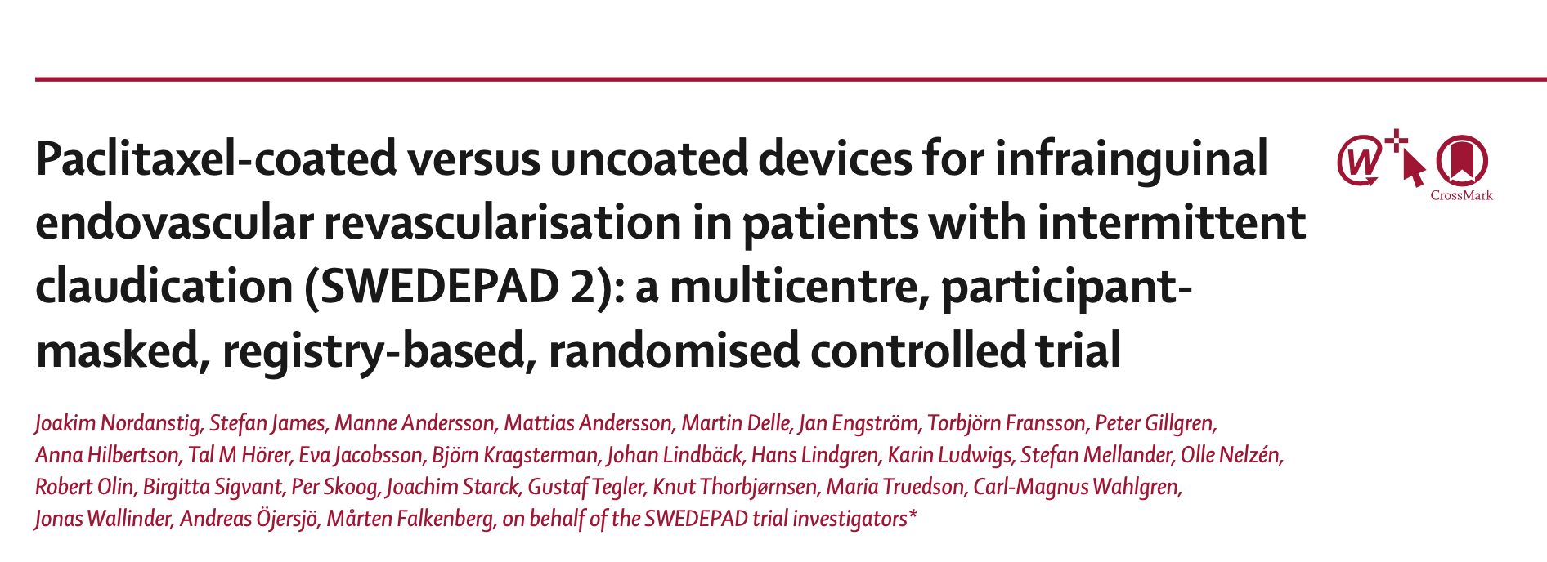

Slide 6

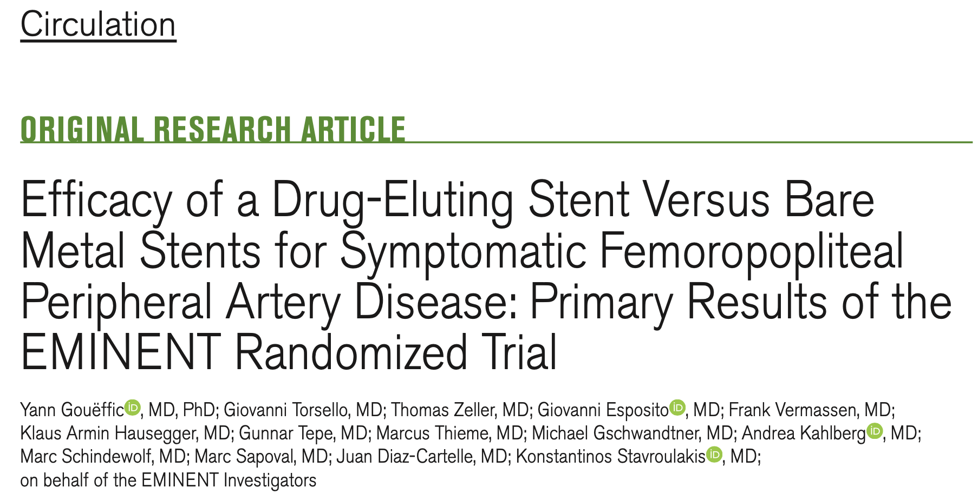

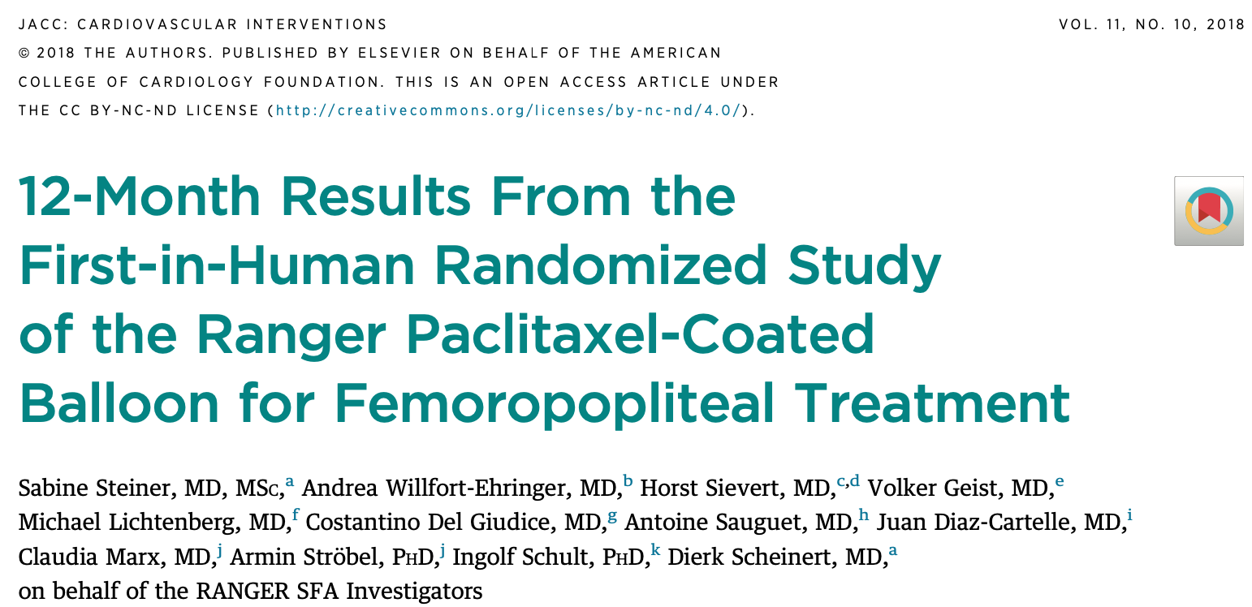
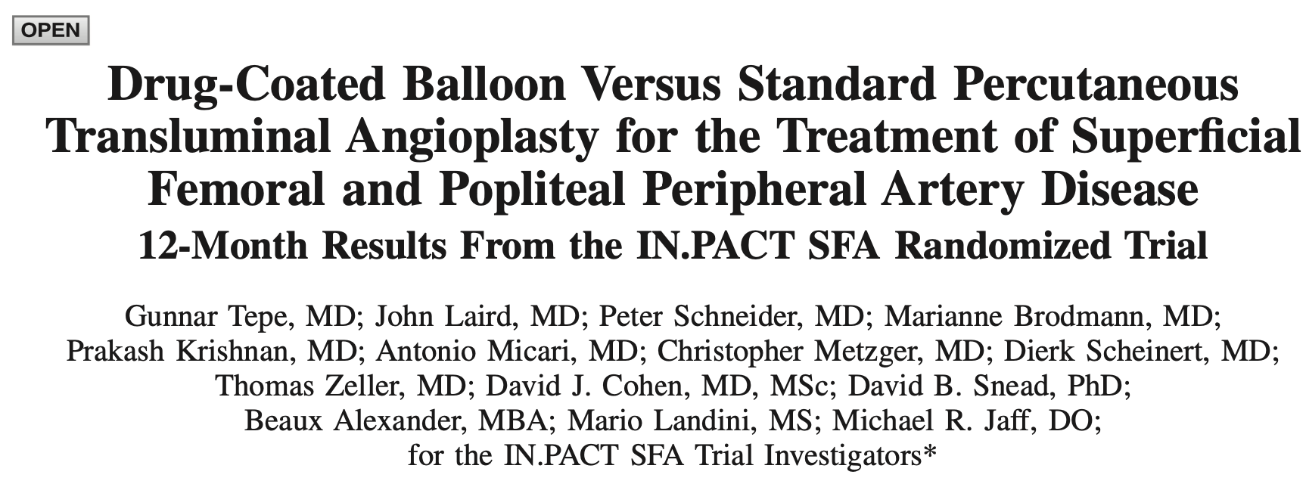
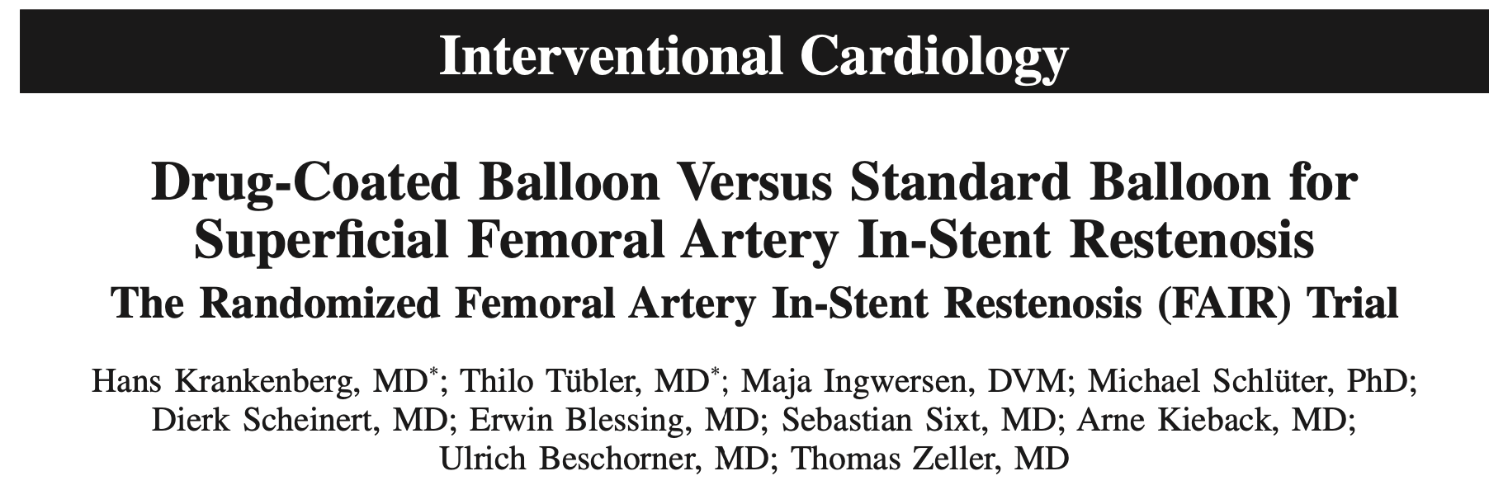
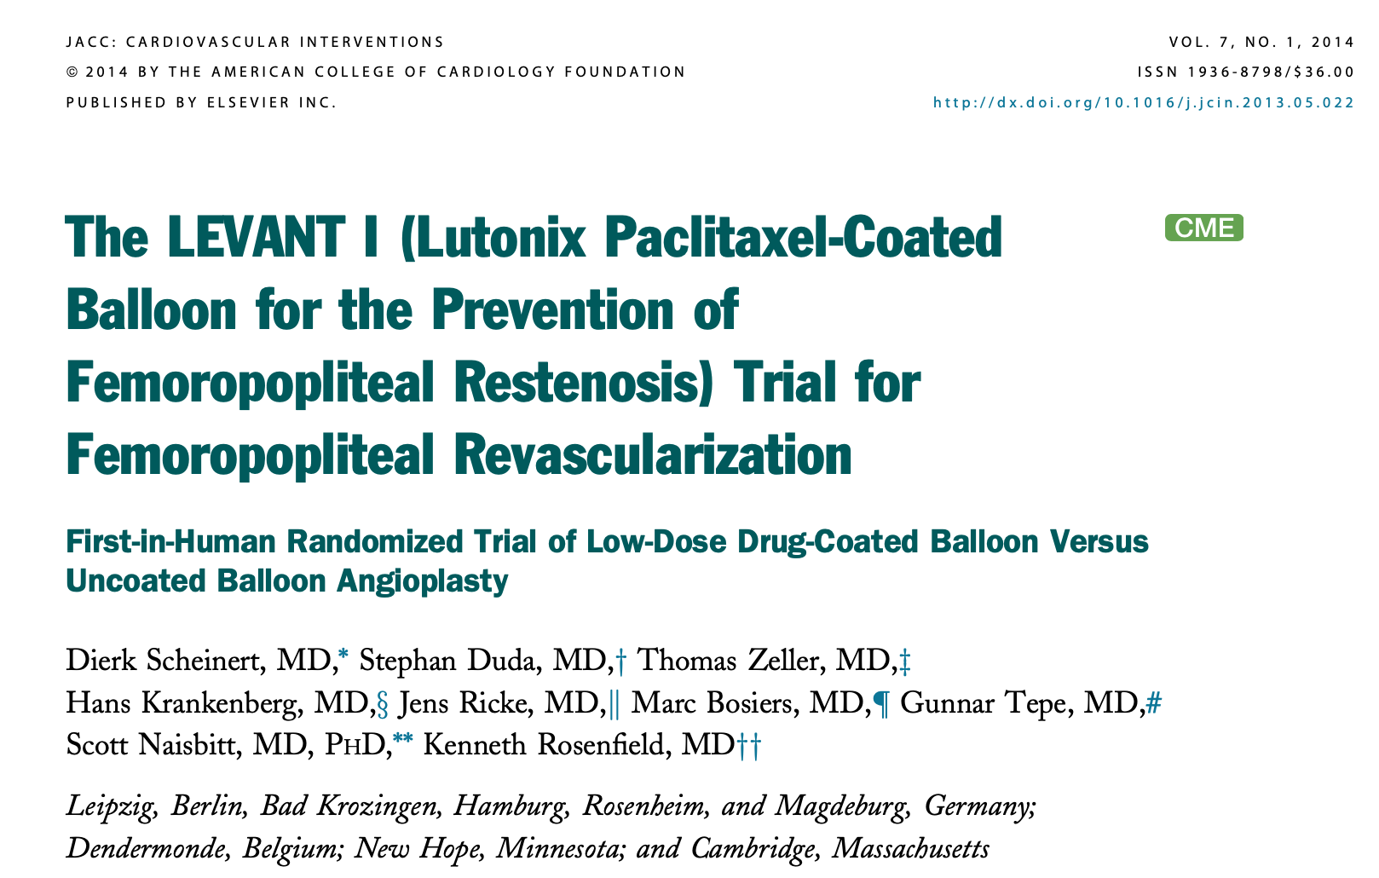
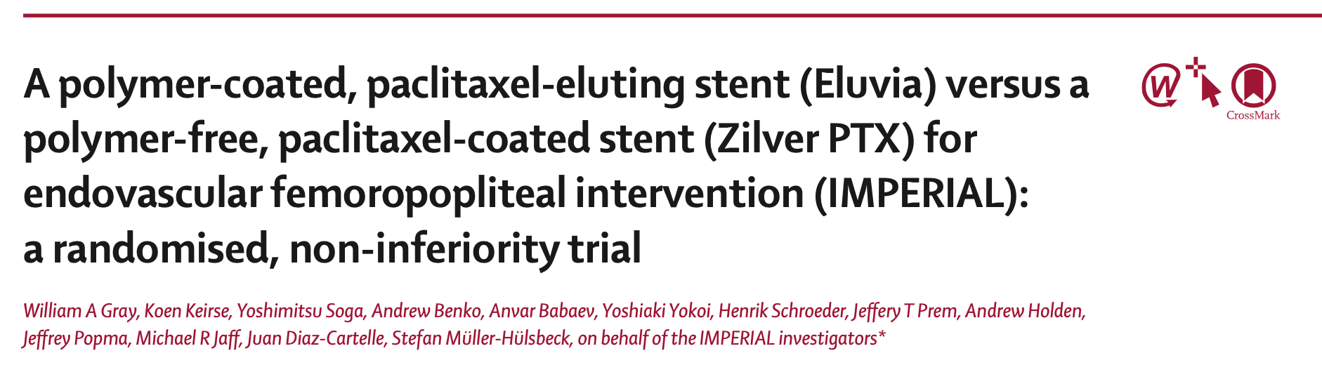
Treatment of Claudication by Paclitaxel Eluting Devices
Gouëffic, Circulation, 2022; Tepe, Circulation, 2014; Steiner, JACC-CI, 2028; Krankenberg, Circulation, 2015; Scheinnert, JACC-CI, 2014; Gray, Lancet, Gray, Lancet, 2018; Dake, Circulation, 2011;

Slide 7
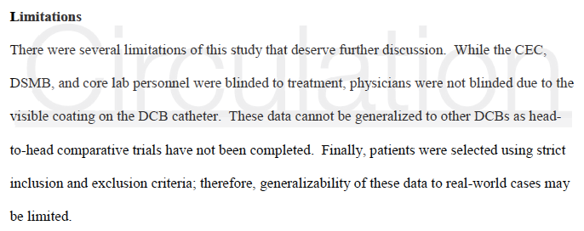
DCB reduced late lumen loss, binary restenosis, and TLR compared with POBA alone in the treatment of femoropopliteal disease.
Clinicaly driven TLR
Primary patency
Limits:
Stenosis > 18-cm Occlusions >10-cm
Severe calcifications
Failure of vessel prep
Caradu, J Vasc Surg, 2019, Tepe, Circulation, 2014; Rosenfield, NEJM, 2015; Schroeder, Circulation, 2017

Slide 8
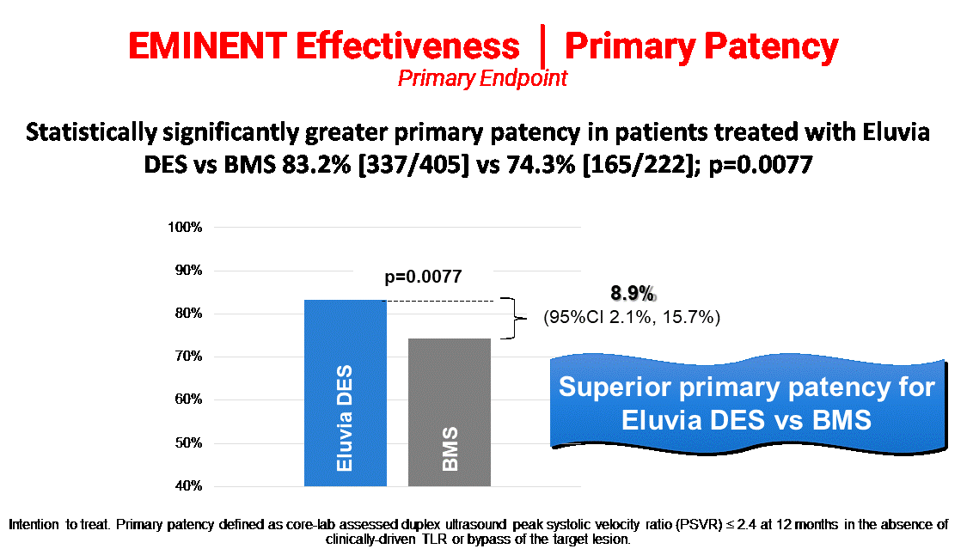
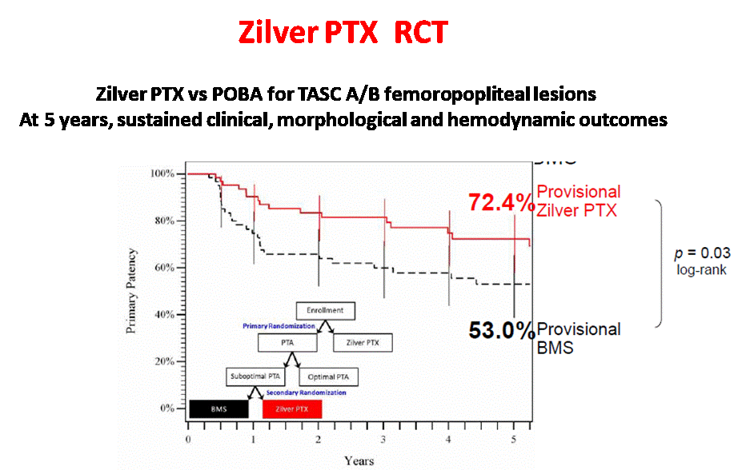
Drug Eluting Stent for Patients with Claudication
775 patients
Mean lesion lenght: 75.6±50.3 and 72.2±47.0 mm in the ELUVIA and BMS groups
479 patients
Mean lesion lenght: 63.1±40.7 66.4±38.9in the ZILVER PTX and PTA groups
Goueffic, Circulation, 2022
Dake, Circulation, 2016

Slide 9
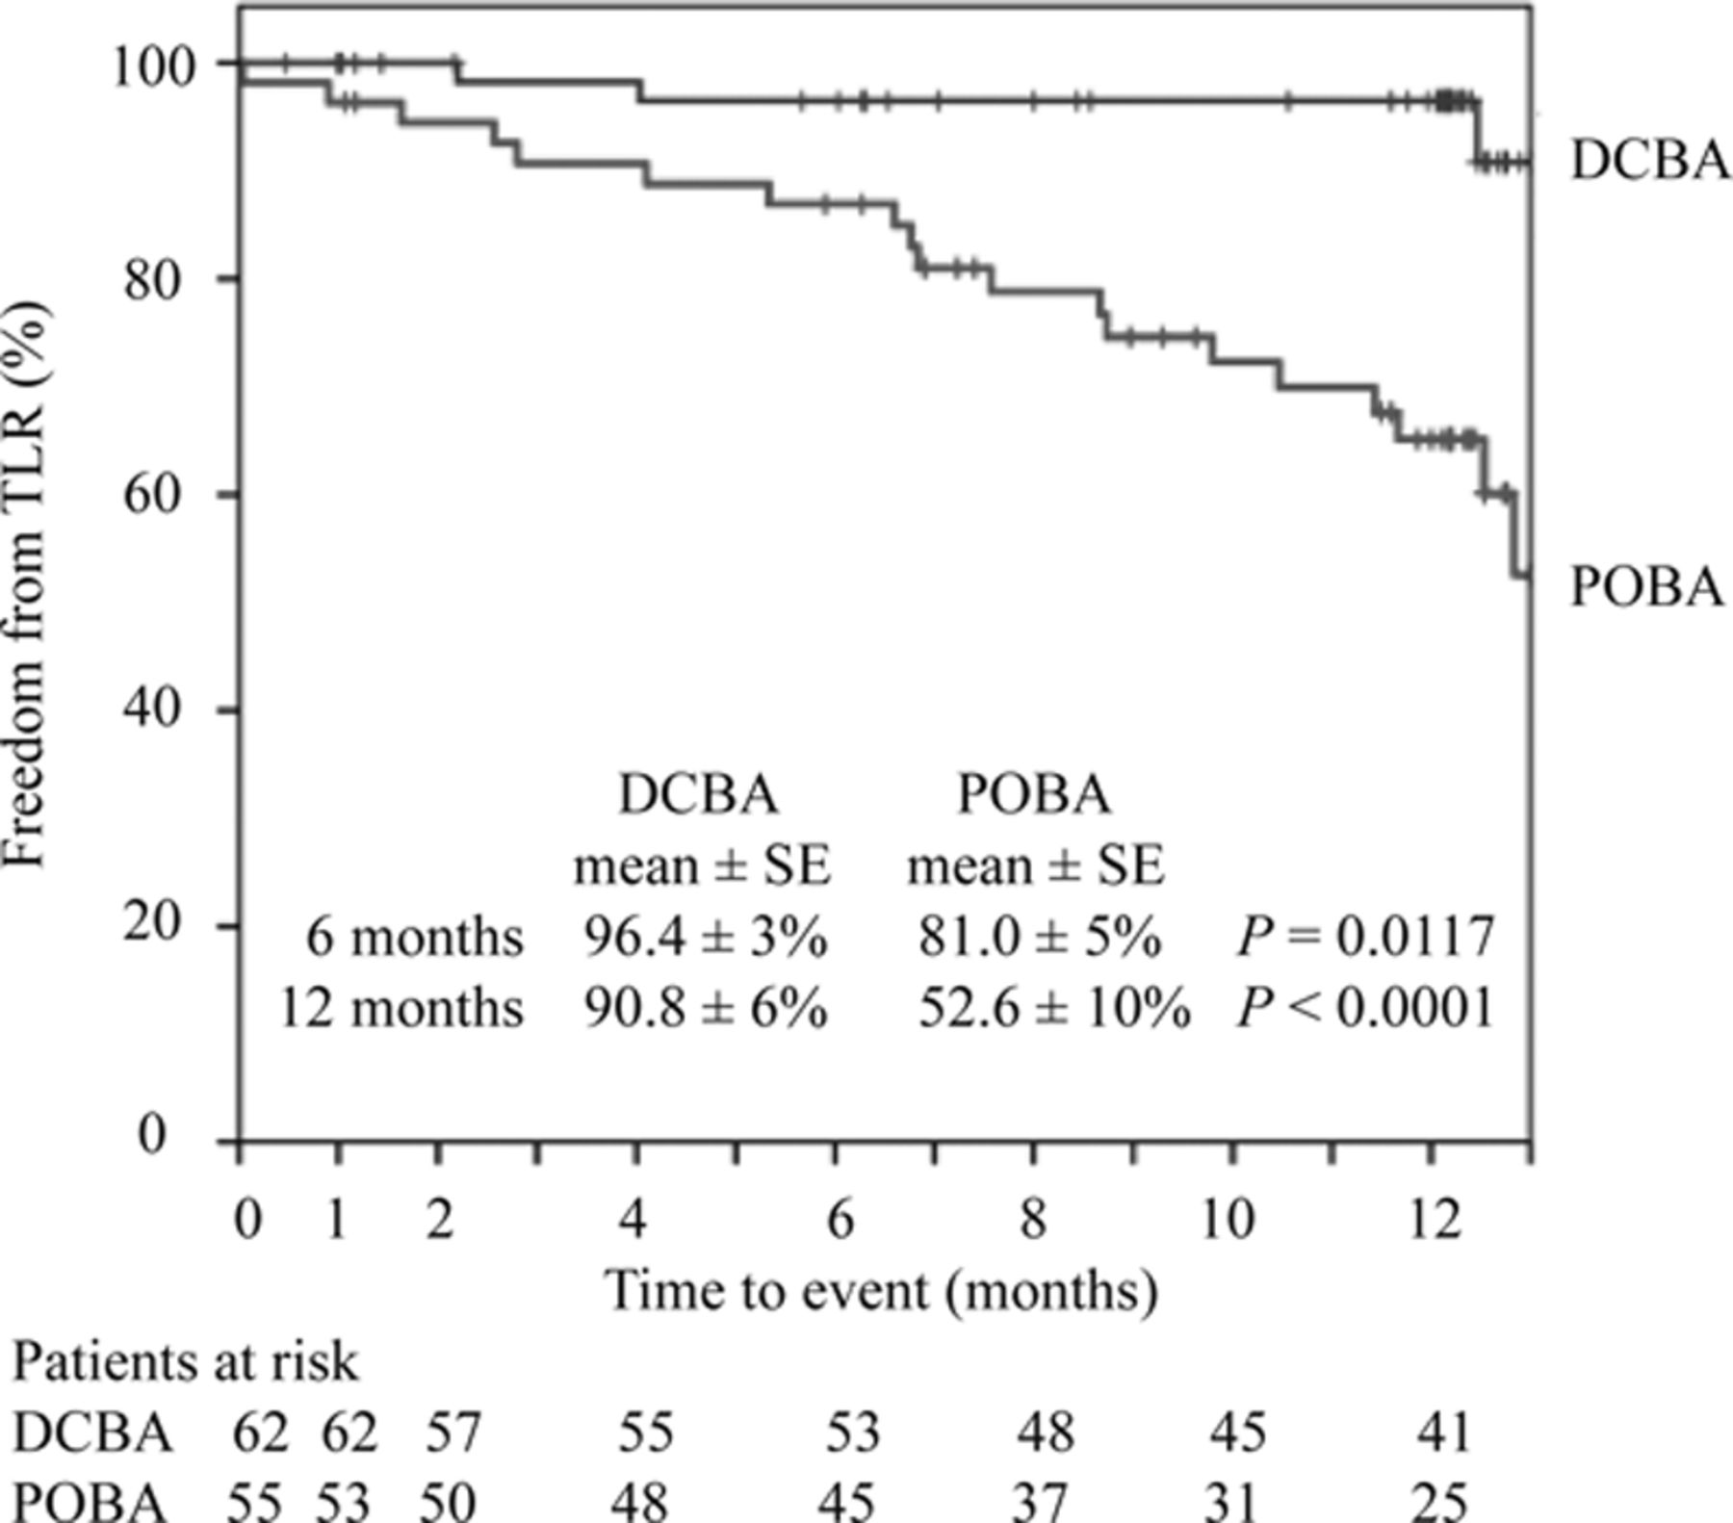
The FAIR Trial - Randomized Femoral Artery In-Stent Restenosis Trial
Drug-Coated Balloon Versus Standard Balloon for Superficial Femoral Artery In-Stent Restenosis
The FAIR trial aimed to evaluate the midterm efficacy and safety of paclitaxel-coated balloons compared to POBA for superficial femoral artery in-stent restenosis.
Outcomes: Significant benefit was seen in the DCB group treated with IN.PACT Admiral compared to POBA
Freedom from CD-TLR
P=0.002
Krankenberg H, et al. Circulation 2015;132:2230-2236.

Slide 10
SWEDEPAD Studies Design
 | SWEDEPAD 1 | SWEDEPAD 2
Principal Investigator | Falkenberg Mårten | Nordanstig Joakim
Design | Pragmatic, nationwide, multicentre,participant-masked, registry-based, randomised controlled trial (1:1 ratio) at 22 Swedish centres
Objective | To assess whether PCD affect the rate of above-ankle amputation in patients with CLTI undergoing infrainguinal endovascular revascularisation. | To assess the effect of PCD on clinically important outcomes in patients with intermittent claudication undergoing infrainguinal endovascular revascularisation.
Primary Endpoint | Ipsilateral major amputation (above the ankle) during follow-up. | The between-group difference in quality of life at 1 year, assessed with the six-item Vascular Quality of Life Questionnaire (VascuQoL-6), a peripheral artery disease-specific quality of life instrument.
Patients | Adult patients with Rutherford category 4–6 scheduled for infrainguinal endovascular treatment | Adult patients with Rutherford category 1–3 scheduled for infrainguinal endovascular treatment
Funding | Swedish Research Council, Swedish Heart Lung Foundation, and the Swedish state under the agreement between the Swedish Government and county councils.
Falkenberg, Lancet, 2025; Nordanstig, Lancet, 2025

Slide 11

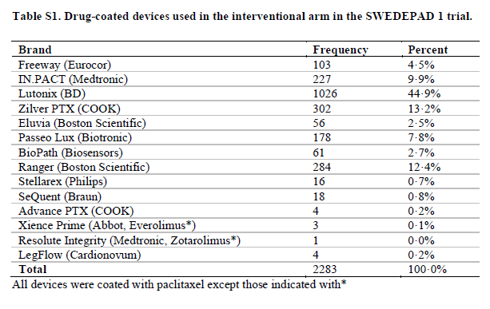
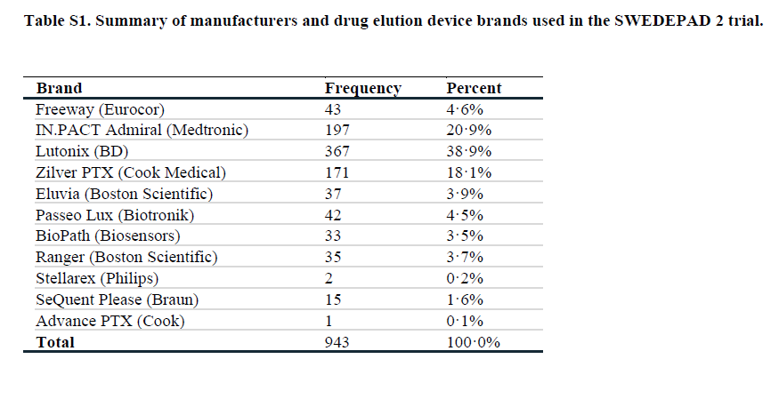
SWEDEPAD Made the Hypothesis of Class Effect
Class Effect ? «Class effect refers to the similar outcomes, therapeutic effects and similar adverse effects of two or more medicines. All products within a class are assumed to be closely related in three concepts: a similar chemical structure, mechanism of action, and pharmacological effects.» (Soares, Rev Port Cardiol, 2002)
Swedepad 1
Swedepad 2

Slide 12
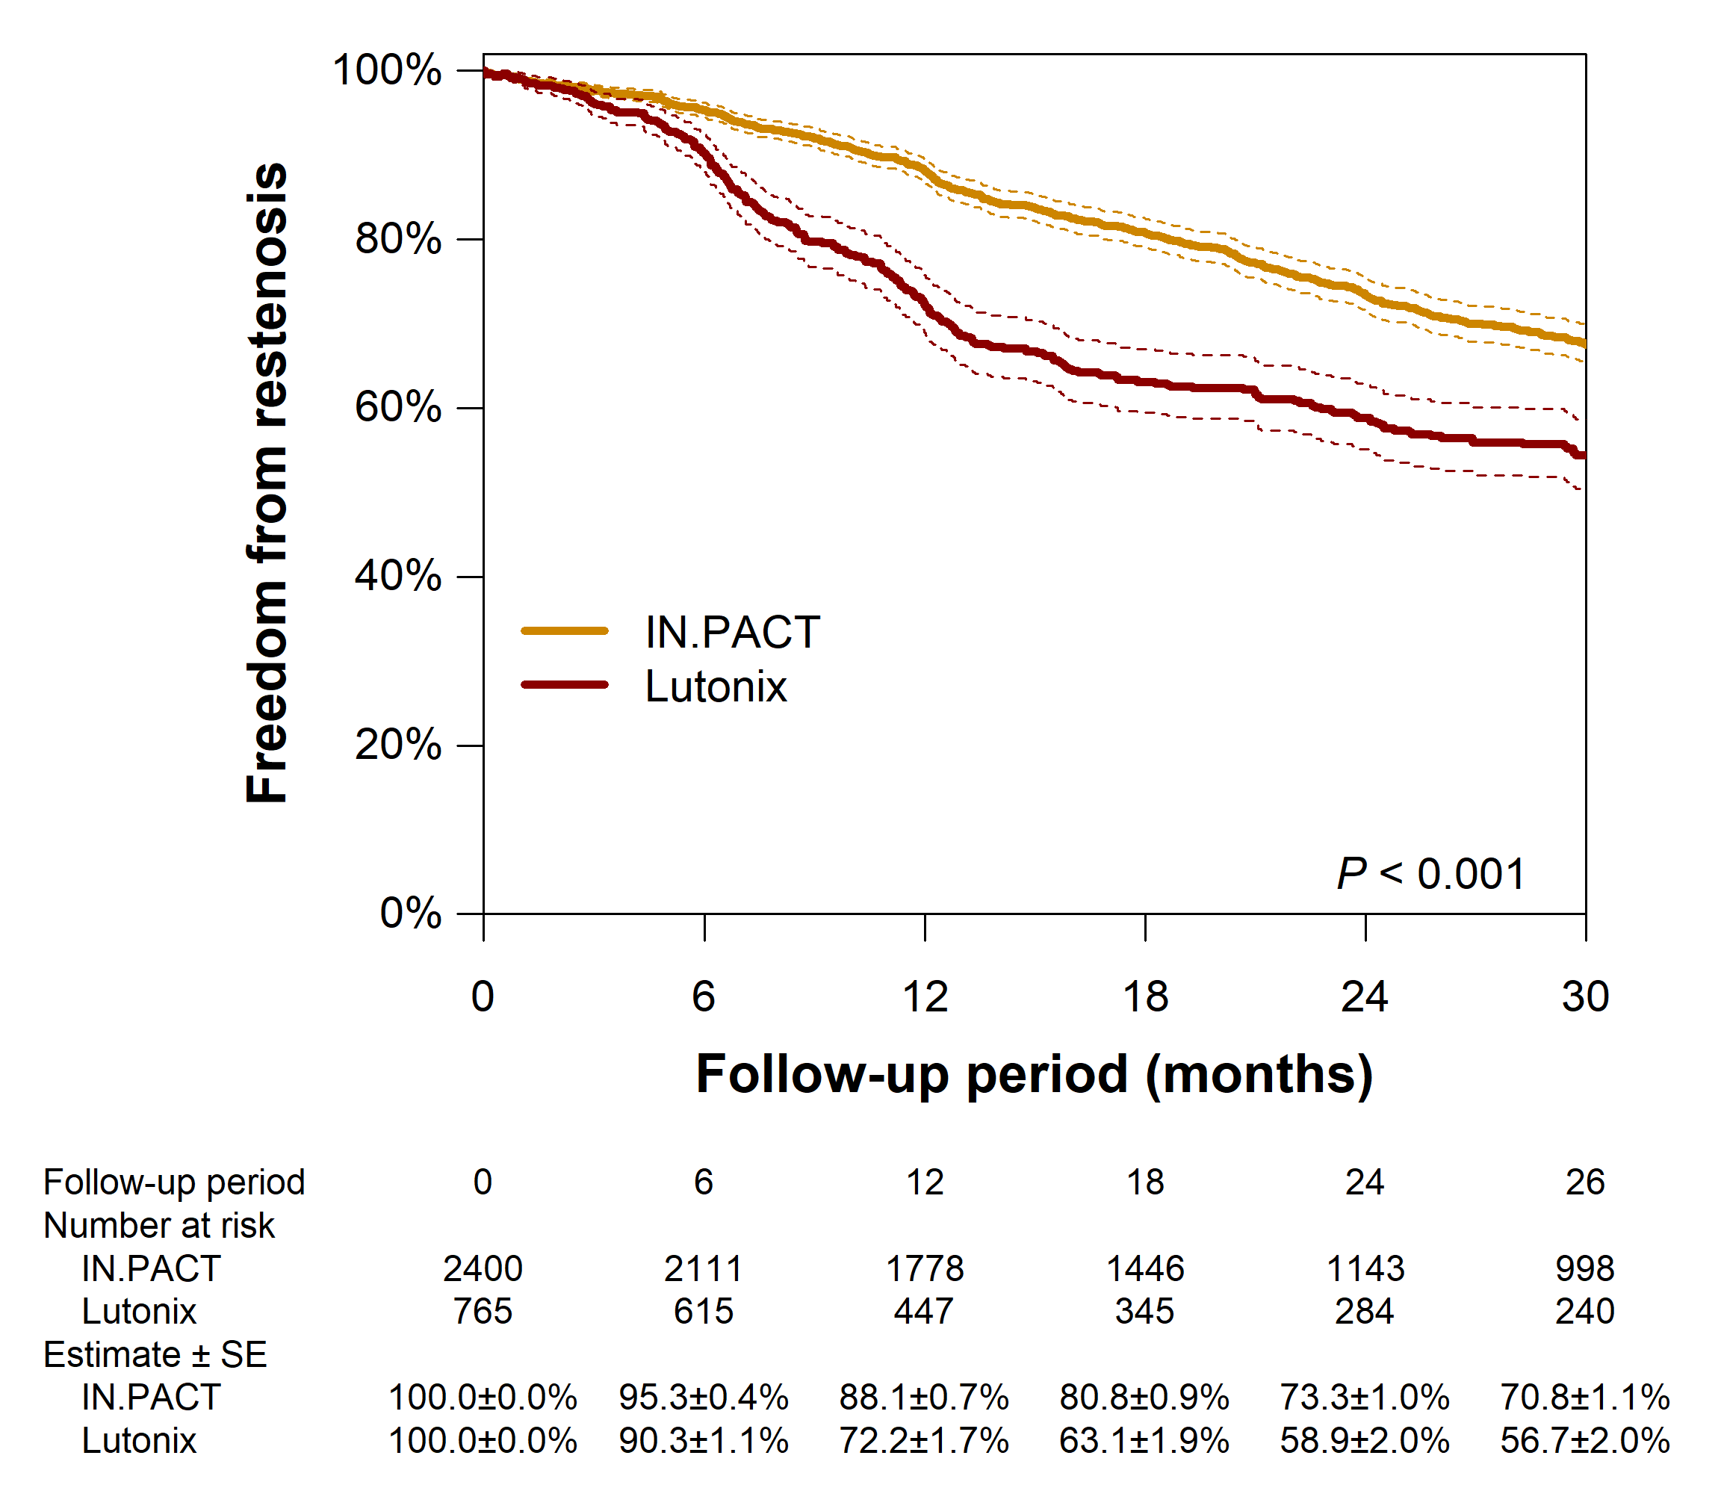
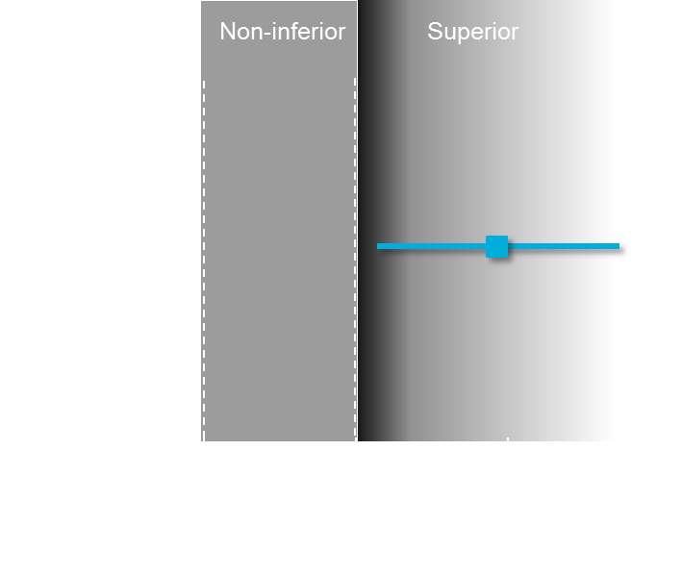
No Class effect Among Drug Eluting Devices
In the SWEDEPAD-2 study, ≃40% of patients received Lutonix and ≃ 4% received Eluvia
IN.PACT vs. Lutonix
ELUVIA vs ZILVER-PTX
88.1%
73.3%
72.2%
58.9%
Fujihara, CVIR Endovascular, 2023
Gray, Lancet, 2018

Slide 13
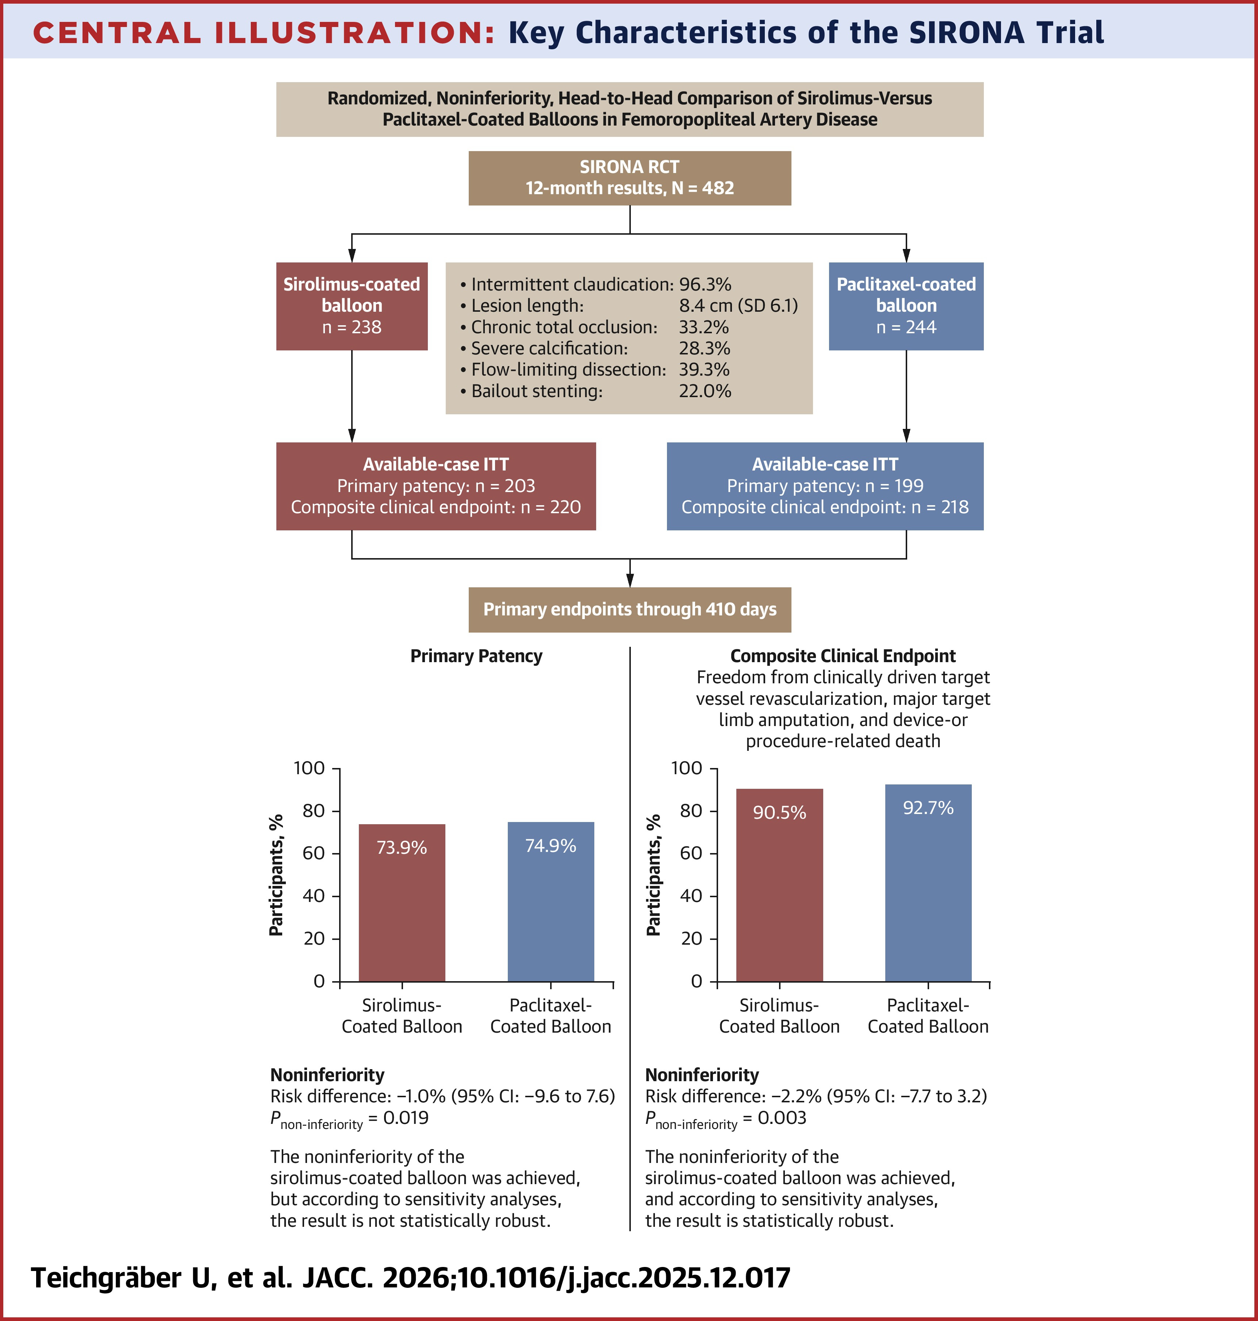
SIRONA
Sirolimus vs Paclitaxel Balloons for Femoropopliteal Disease (SIRONA Trial)
Study and population
Randomised, controlled, non-inferiority trial in patient with symptomatic femoropopliteal artery. (Magic Touch® PTA sirolimus drug- coated balloon)(PCB types are available for selection upon investigator’s discretion
Primary endpoints
Efficacy: primary vessel patency at 12 months.
Safety: composite of freedom from CD-TLR, major target limb amputation, and device- or procedure-related death at 12 months.
Key Findings:
Efficacy: 150/203 (73.9%) with SIROLIMUS vs 149/199 (74.9%) with PACLITAXEL (risk difference: -1.0%; 95% CI: -9.6% to 7.6%; P_non-inferiority = 0.019).
Safety: 199/220 (90.5%) with SCBs vs 202/218 (92.7%) with PCBs (risk difference: -2.2%; 95% CI: -7.7% to 3.2%; P_non-inferiority = 0.003).

Slide 14
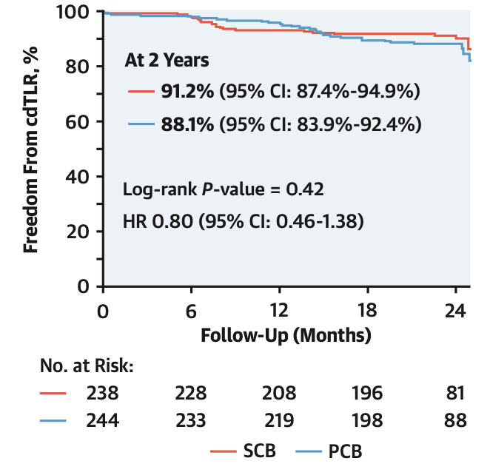
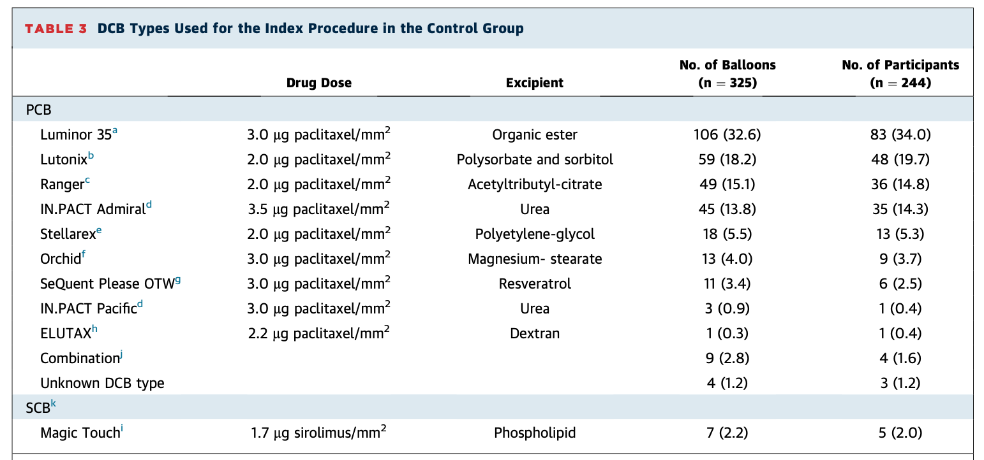
SIRONA @ 2-years
Sirolimus vs Paclitaxel Balloons for Femoropopliteal Disease (SIRONA Trial)
Teichgräber, JACC-CI, 2026

Slide 15
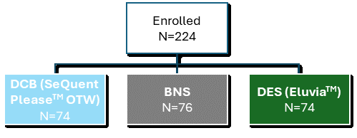
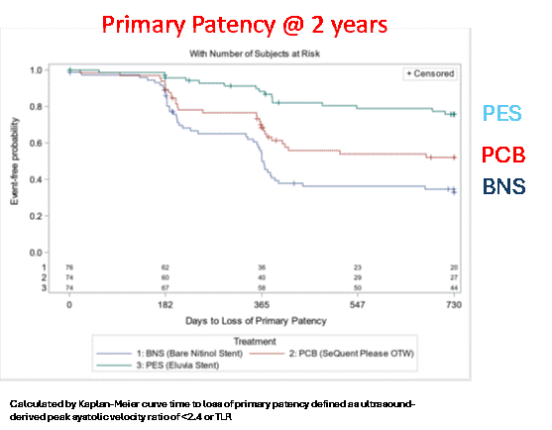
No Class effect Between DES and DCB
In the SWEDEPAD-2 study, DCB: 78% - DES: 22%
SPORTS RCT (1:1)
Objective | Compare DES (EluviaTM), DCB (SeQuent PleaseTM OTW, BBraun), or bare nitinol stent for TASC C/D femoropopliteal lesions
Primary Endpoint | Angiographic diameter stenosis at 12 months (core lab)
Patients | N=224 Key inclusion criteria: Rutherford classes 2-4 Lesion length at least 13 cm (treatment length at least 15 cm) Lesions in the SFA and/or proximal popliteal artery
 | PCB (n = 74) | PES (n = 74) | BNS (n = 76) | P value
Lesion length, mm, mean ± SD$1$ | 221 ± 87 (n=73) | 235 ± 78 (n=73) | 227 ± 78 (n=75) | 0.57
¶ Log-rank test for difference of treatment groups.

Slide 16
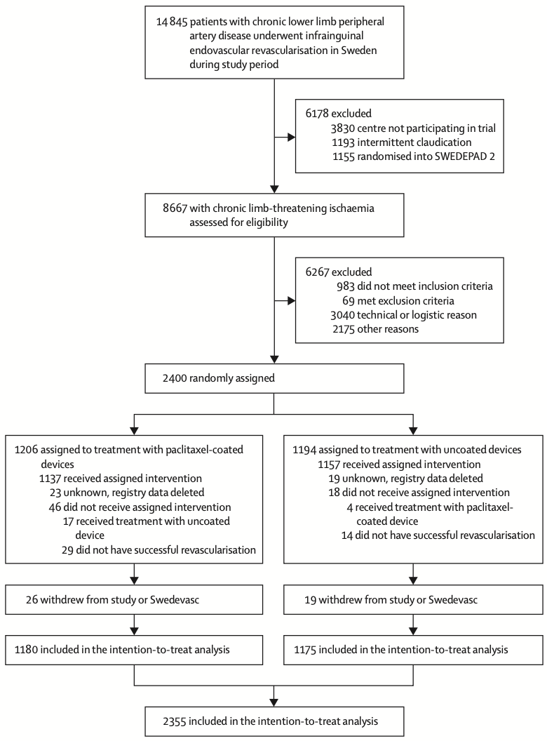
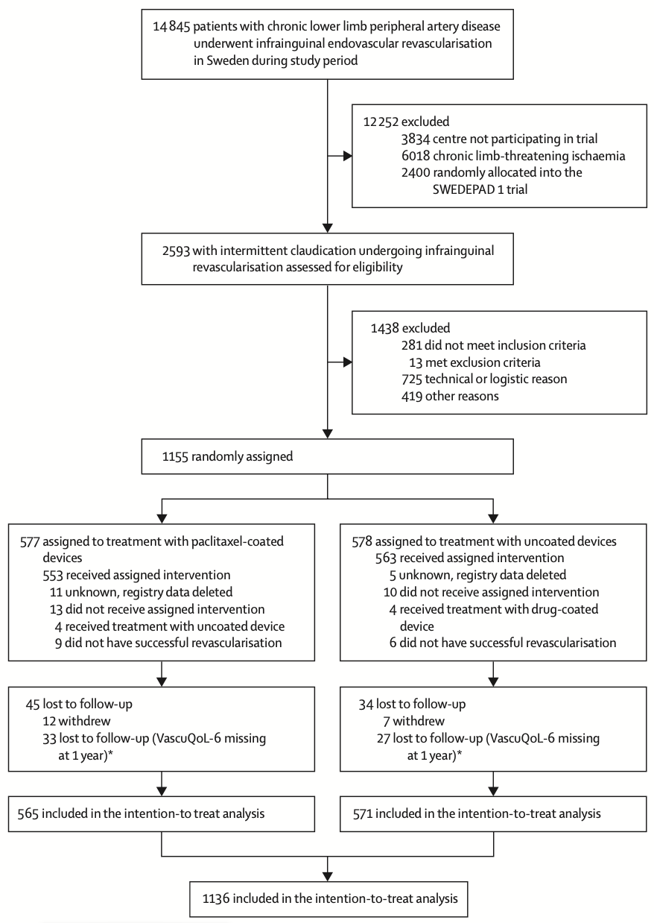
SWEDEPAD 1-2 Flow Charts
2355 included
in the intention-to-treat analysis
1136 included
in the intention-to-treat analysis
Falkenberg, Lancet, 2025
Nordanstig, Lancet, 2025

Slide 17
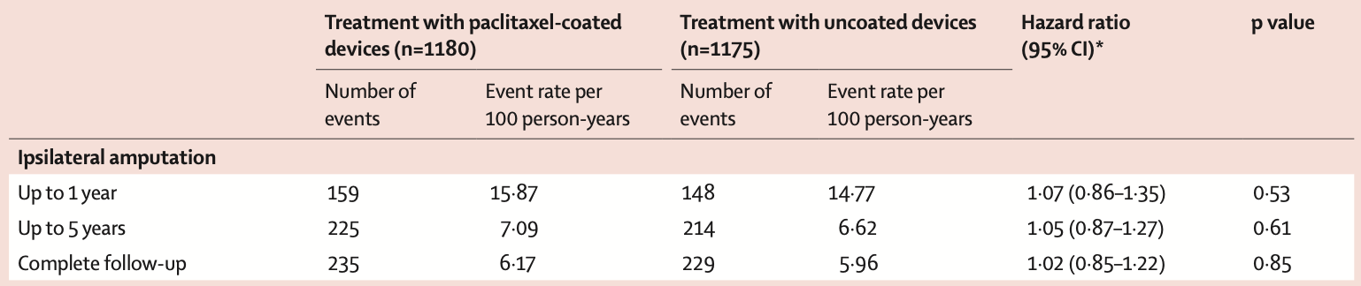
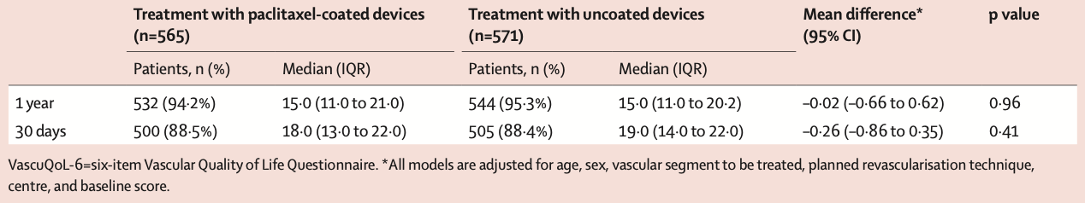
SWEDEPAD 1 Outcomes
There was no statistical difference between the paclitaxel-coated and uncoated groups for the primary endpoint of ipsilateral major amputation (HR 1·05 [95% CI 0·87–1·27]; p=0·61 at 5 years of follow-up in the intention-to-treat analysis
SWEDEPAD 2 Outcome: VascuQol-six-items
At the 1-year follow-up, the intention-to-treat analysis showed no difference in VascuQoL-6 scores between the treatment groups.
Falkenberg, Lancet, 2025; Nordanstig, Lancet, 2025

Slide 18
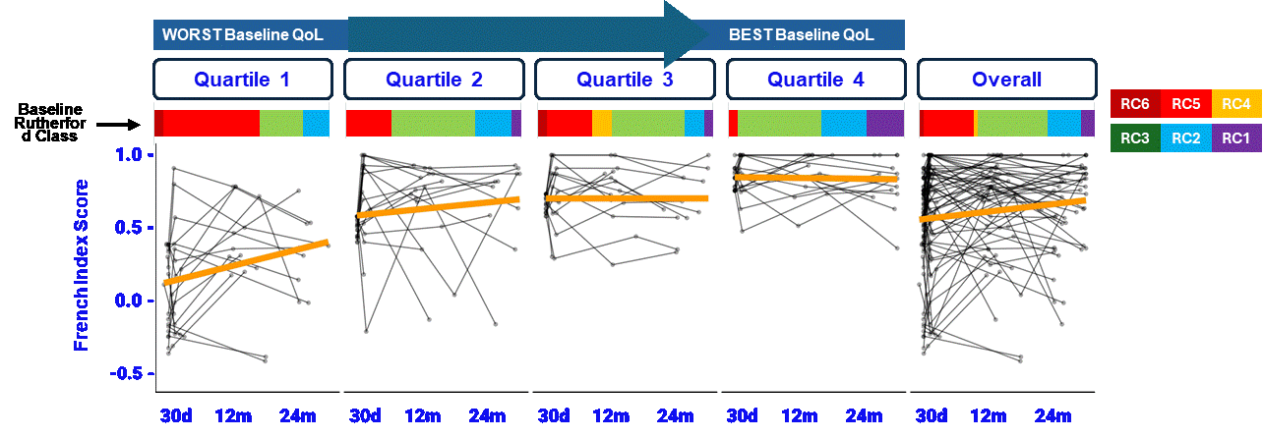
Patients Selection and Quality of Life
In the SWEDEPAD-2 study, >40% of patients presented Rutherford classes 1-2
Patients in the lowest EQ-5D quartile at baseline had the greatest quality of life improvement over time.
Patients in the highest EQ-5D quartile at baseline demonstrated no improvement.
Gouëffic, JAHA, Submitted
Notes:
This graph is a little complex, so I'll walk you through it. This looks at the quality of life change over time adjusted for the baseline quality of life. So here in the bottom you can see the 30 day, 12 months and 24 months data.
For each quartile of patients based on their baseline quality of life. So quartile one had the worst baseline quality of life, while quartile 4 had the best baseline quality of life. And what this is showing is that the quality of life improvements Were more profound in patients with the worst baseline. So those patients with the worst baseline quality of life had the greatest improvement, whereas those that started out already doing pretty good didn't really show a significant improvement here. And this is just because this isn't a ceiling effect In the data.
And you can see also with these little heat maps across the top that the disease severity in these patients, not surprisingly those with the worst baseline quality of life tended to be Rutherford five and six patients with critical limb ischemia. Whereas those with the best quality of life at baseline tended to be claudicant patients here. And the reason this is important is because we've seen recently, if you've heard of the SWEDEPAD study, some studies showing no benefit in terms of quality of life for DCB.
Yet they enrolled primarily claudicants in their cohort. So the point of this slide is to show that the improvement in quality of life is dependent on the disease severity and how sick your patients are at baseline.

Slide 19
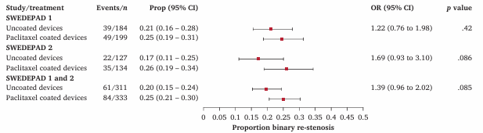
Absence of a Reduction in Binary Re-stenosis in SWEDEPAD Trials
Graphical chart representing the proportion of binary re-stenosis in patients from SWEDEPAD-1, SWEDEPAD-2, and the combined SWEDEPAD 1 and 2 cohorts. Data are presented as proportions (95% CI) and OR (95% CI) for binary re-stenosis. Prop = proportion, OR = odds ratio, CI = confidence interval.
Le Corvec, Eur J Vasc Endovasc Surg, 2026

Slide 20
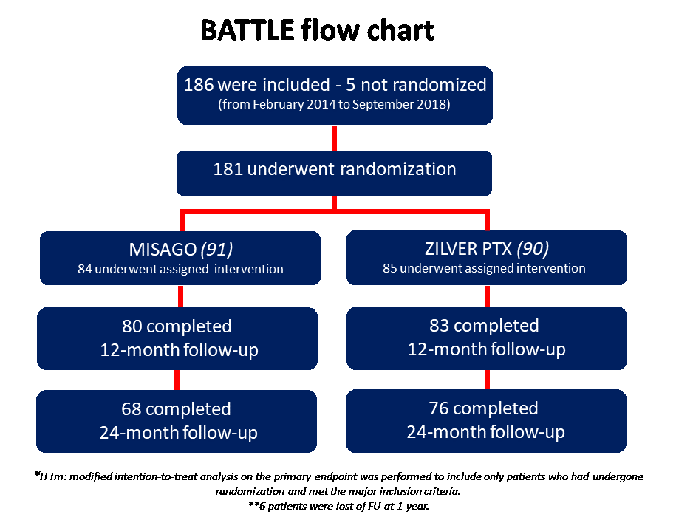
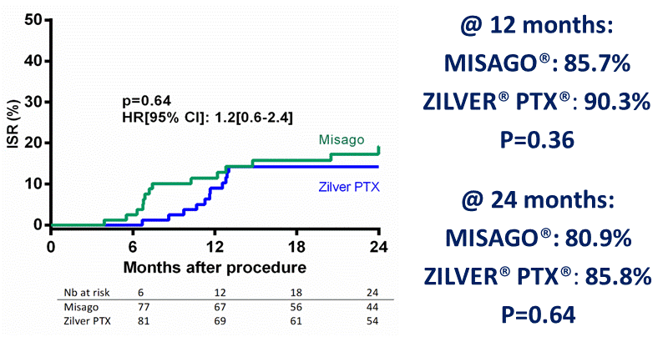
Freedom from in-stent restenosis* @ 12 months (primary endpoint) (Kaplan Meier estimates)
*Defined by restenosis of >50% and by a peak systolic velocity index >2.4 at the target lesion. Assessment by an independent core laboratory (thromboses were excluded)
Goueffic, JACC-CI, 2020

Slide 21
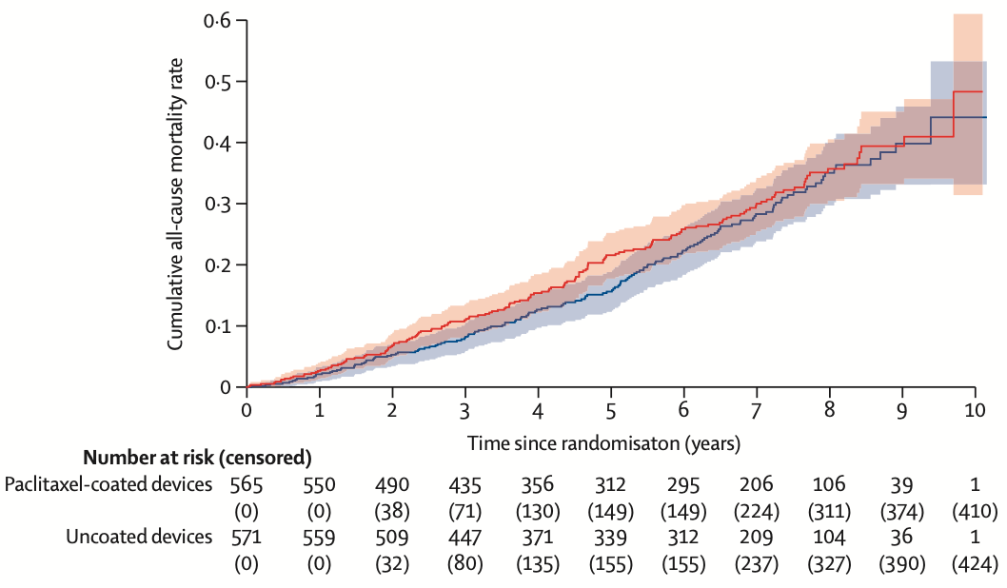
In 2025: DOUBT ABOUT THE SAFETY…AGAIN ?
The incidence of all-cause mortality over 5 years was 4·57 (95% CI 3·73–5·54) deaths per 100 person-years in the paclitaxel-coated group and 3·28 (2·59–4·10) per 100 person-years in the uncoated group.
- The study was not designed for this purpose
- The signal is not consistent
- The cause of this signal among patients with claudication remains uncertain.
Nordanstig, Lancet, 2025

Slide 22
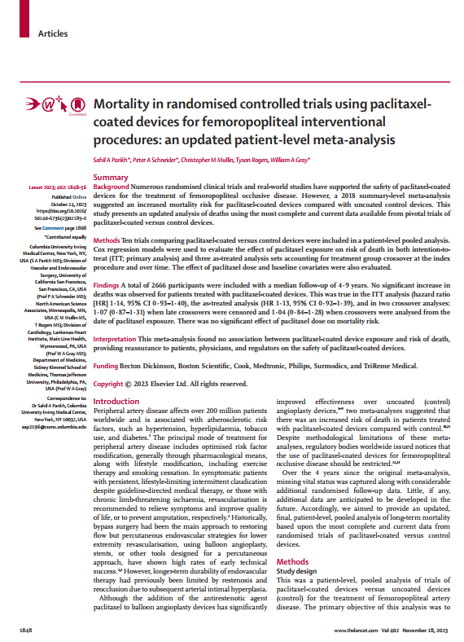
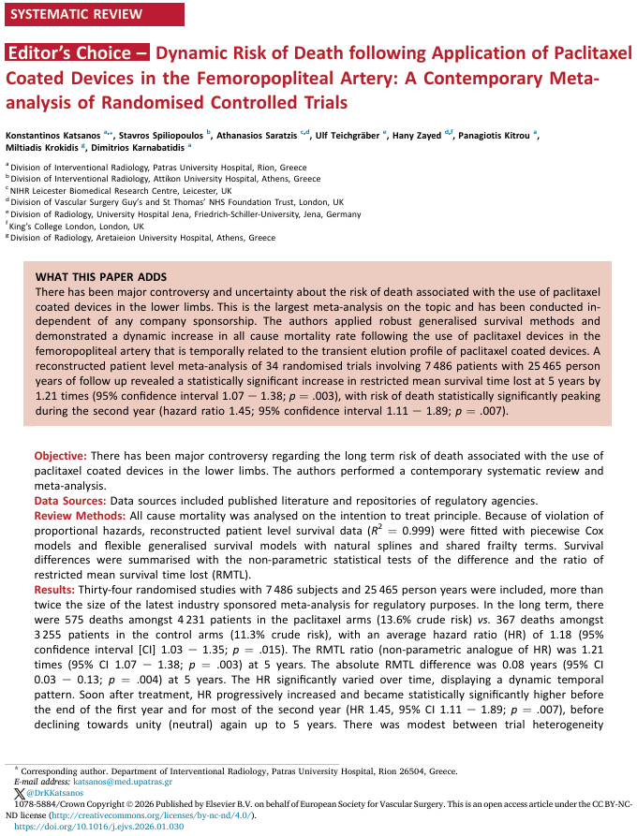
Paclitaxel-Coated Device and Exposure and Risk of Death
(Pooled Data)
2666 participants
7486 participants
Prakish, Lancet, 2023; Katsanos, Eur J Vasc Endovasc Surg, 2026

Slide 23
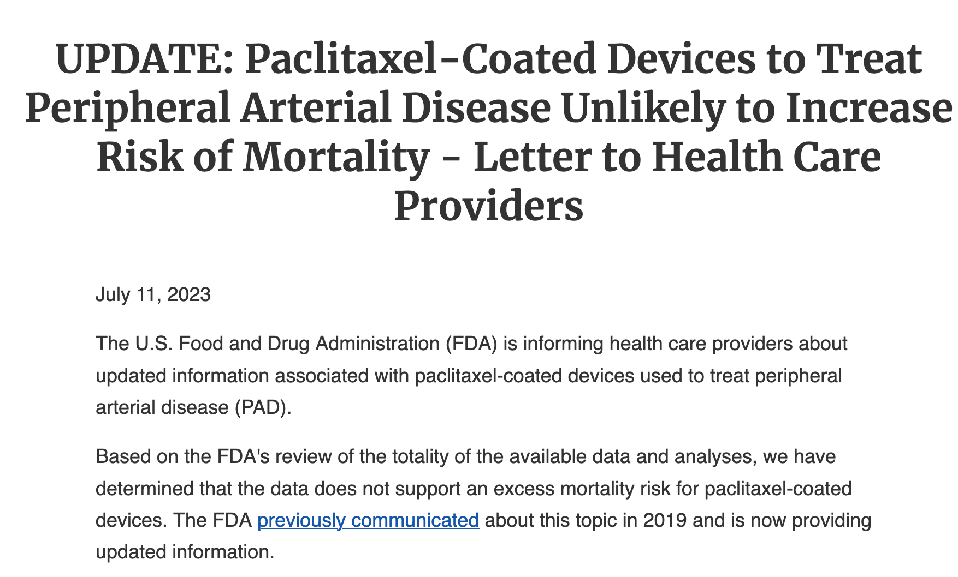

Slide 24









The French National Health Data System (SNDS) Positions France as a Key Country for Research
National health insurance fund
Technical agency for information on hospital care
National Institute of Health and Medical Research
SNIIRAM: 15 datasets on primary care
(patient characteristics, practitioner, retail pharmacy, benefits, private hospitals, biology, medical devices…)
PMSI: private & public hospital activity
(hospital stays, external activity, expensive medicines)
CépiDC: causes of death
(national statistics repository)
Not available yet
National Solidarity Fund for Autonomy
Disability Database
(national statistics repository)
Sample from complementary health insurance
Database of public insurance data representing approximately 99% of the French population
General Beneficiary Sample (EGB)
Permanent representative sample
(1/97 random sample size)
Each patient’s healthcare use is tracked from birth or immigration to France to death or emigration, regardless of employment or socioeconomic status.
Catalog of public cohorts

Slide 25
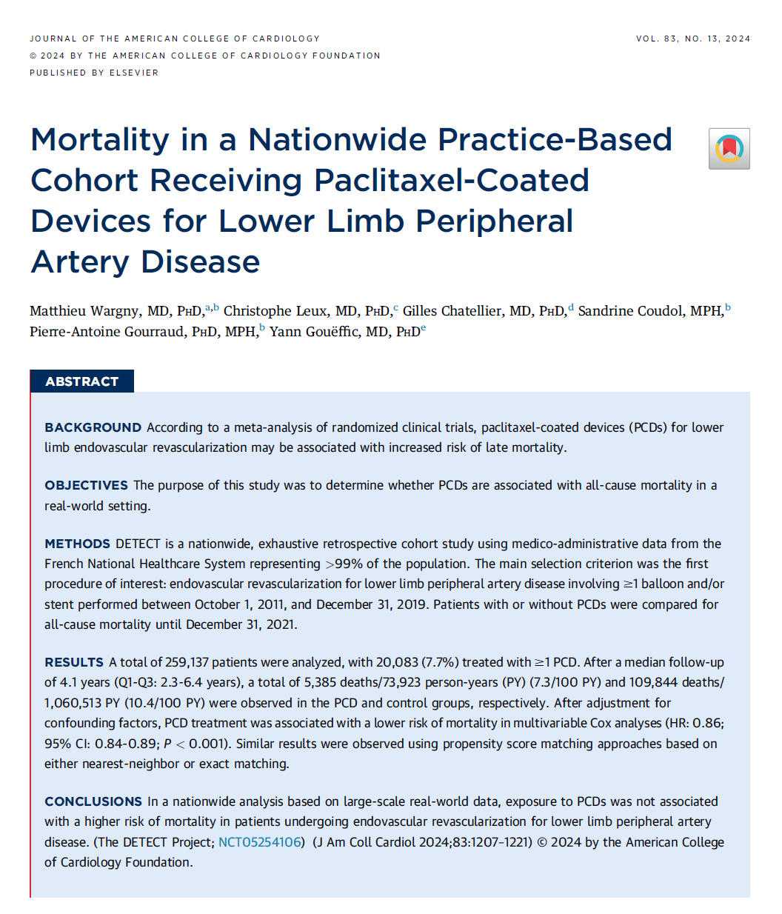
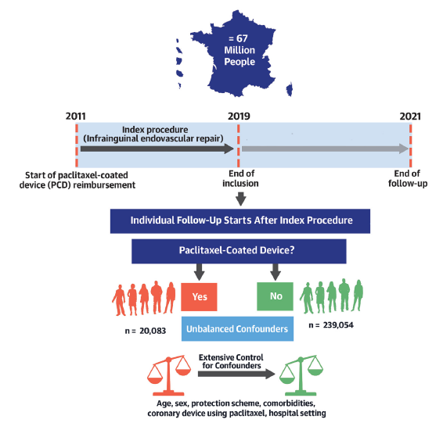
Analysis of Paclitaxel Safety in the SNDS: The DETECT Study
Wargny et al. J Am Coll Cardiol. 2024

Slide 26
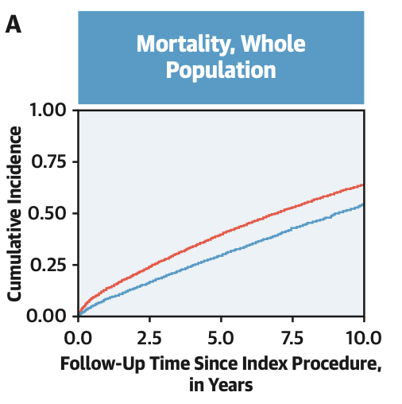
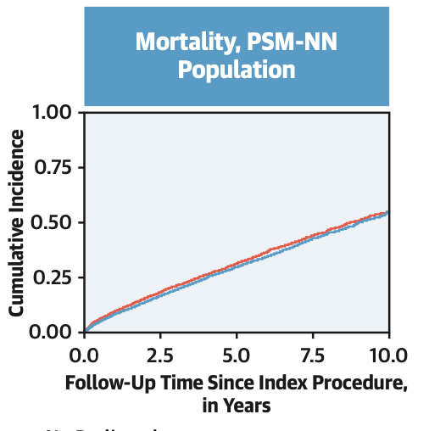
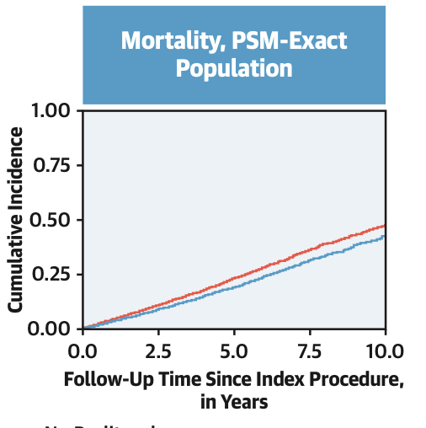

DETECT Study Outcomes
259,137 patients were analyzed
- After a median 4.1 years-FU: 7.3 vs 10.4 deaths per 100 PY in the PCD and control groups, respectively.
- After adjustment for confounding factors, PCD treatment was associated with a lower risk of mortality in multivariable Cox analyses (HR: 0.86; 95% CI: 0.84-0.89; P < 0.001).
- Similar results with propensity score matching approaches based on either nearest-neighbor or exact matching.
PSM was performed on a 1:1 pairing basis, using 2 approaches, NN or “exact” matching, including all of the following: age, sex, time of the index procedure (nominal, 33 categories), protection scheme (nominal, 5 categories), routine treatment (antiplatelet agent, anticoagulant, angiotensin-converting enzyme inhibitor, statin), medical history (coronary artery disease, stroke, heart failure, peripheral artery disease, lower-limb amputation [nominal: no amputation/minor/major], diabetes mellitus, kidney disease [none/ chronic/end-stage], malignant tumor) and index-procedure related history (hospital setting public vs private, admission via emergency unit, lower limb ulcer, procedure involving several arteries). CIF 1⁄4 cumulative incidence function; LLAP 1⁄4 lower limb artery procedure; MACE-A 1⁄4 major adverse cardiovascular event including amputation
Notes:
After a median follow-up of 4.1 years (Q1-Q3: 2.3-6.4 years), a total of 5,385 deaths/73,923 person-years (PY) (7.3/100 PY) and 109,844 deaths/ 1,060,513 PY (10.4/100 PY) were observed in the PCD and control groups, respectively. After adjustment for confounding factors, PCD treatment was associated with a lower risk of mortality in multivariable Cox analyses (HR: 0.86; 95% CI: 0.84-0.89; P < 0.001). Similar results were observed using propensity score matching approaches based on either nearest-neighbor or exact matching.
PY = Person Year

Slide 27
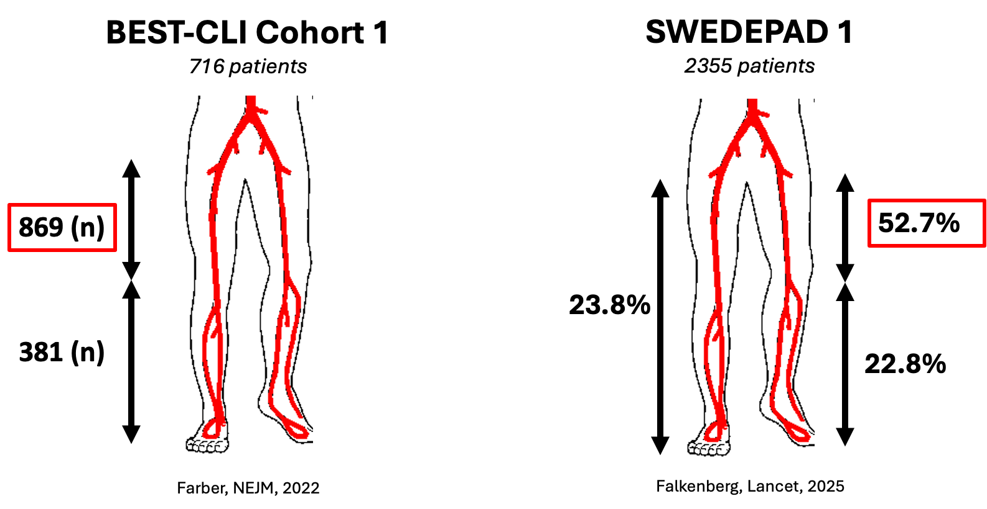
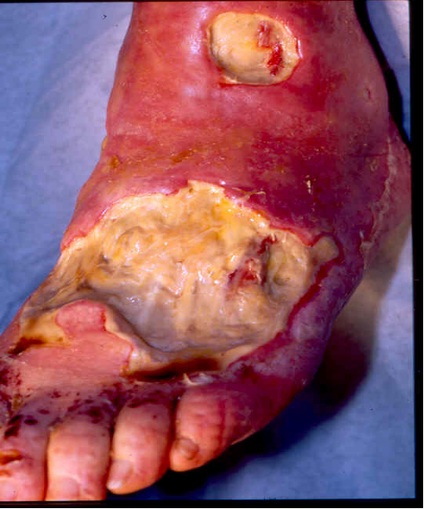
Femoropopliteal Endovascular Treatment of Paitents with Chronic Limb Threatening Ischemia

Slide 28
SWEDEPAD 1 Outcomes: ipsilateral major amputation
There was no statistical difference between the paclitaxel-coated and uncoated groups for the primary endpoint of ipsilateral major amputation (HR 1·05 [95% CI 0·87–1·27]; p=0·61 at 5 years of follow-up in the intention-to-treat analysis
SWEDEPAD 2 Outcome: VascuQol-six-items
At the 1-year follow-up, the intention-to-treat analysis showed no difference in VascuQoL-6 scores between the treatment groups.
Falkenberg, Lancet, 2025; Nordanstig, Lancet, 2025

Slide 29

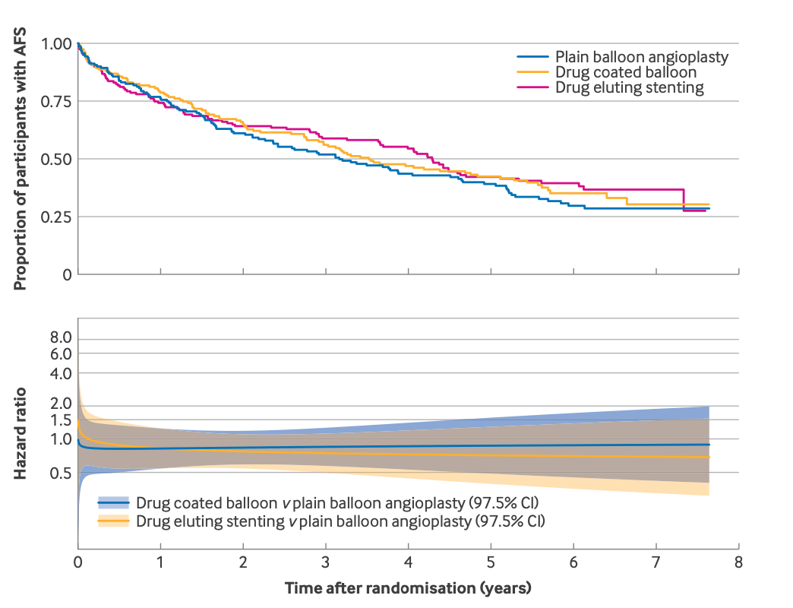
BASIL 3 RCT
To determine which primary endovascular revascularisation strategy represents the most clinically e!ective treatment for patients with CLTI who require endovascular femoro-popliteal, with or without infra-popliteal, revascularisation (POBA, DCB, DES)
The median time to last clinical follow-up was 2.1 years (range 0-7.2 years)
Major amputation or death occurred in
106 of 160 (66%) participants in the POBA±BMS group
97 of 161 (60%) in the DCB±BMS group,
93 of 159 (58%) in the DES group
Adjusted hazard ratios: PBA±BMS v DCBA±BMS: 0.84, 97.5% confidence interval 0.61 to 1.16, P=0.22; PBA±BMS v DES: 0.83, 0.60 to 1.15, P=0.20.
Bradbury, BMJ, 2025
Notes:
Amputation free survival (AFS) Kaplan-Meier plot and hazard ratio over time fitted assuming non-proportional hazards (intention-to-treat analysis). CI=confidence interval

Slide 30
Take Home Message for Paclitaxel in the Femoropopliteal Segment
Efficacy
  Robust high-level evidence supports the use of paclitaxel-eluting devices in patients with claudication and lesion subsets.
  Evidence in patients with CLTI are lacking
  Pragmatic studies have failed to demonstrate a significant advantage of paclitaxel-eluting devices in unselected patients and lesions.
  No class effect has been demonstrated
Safety
  A mortality signal has been observed in some patient-level analyses but has not been confirmed in large real-world datasets.

Slide 31
Drug Elution in the Femoropopliteal Segment: Paclitaxel Remains the First Choice
Yann Gouëffic, MD, PhD
Department of vascular and endovascular surgery, Groupe Hospitalier Paris Saint Joseph, Paris, France.
Notes:
Guidelines
We want to extend the endo ttt
Surgery has a low co morbidity rates
Endo has a lower co morbidity rates
However assessment was based on TASC and TASC mix the CTO (most challenging lesions) with stenosis
CTO good tk success
CTO with covered stent

Slide 33
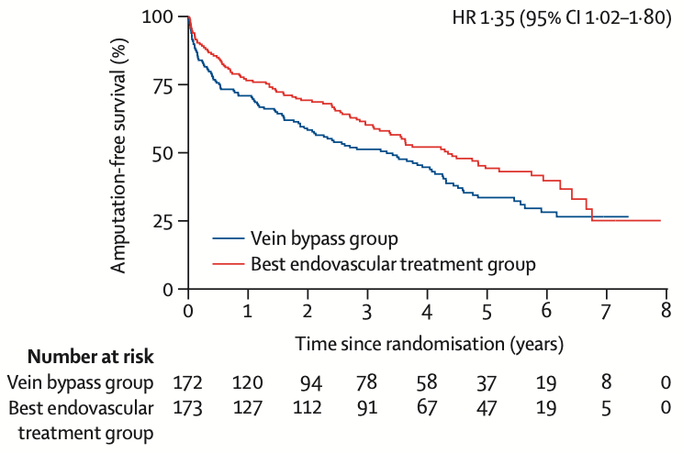
BASIL 2 RCT: Amputation Free Survival
Bypass vs Angioplasty in Severe Ischaemia of the Leg (BASIL) trial
Major amputation or death
Vein bypass group: 108 (63%) of 172 patients
Best endovascular group: 91 (53%) of 173 patients
Adjusted HR 1·35 [95% CI 1·02–1·80]; p=0·037
The median amputation-free survival was:
3·3 years [IQR 2·1–4·3] in the vein bypass group
4·4 years [IQR 3·4–5·9] in the best endovascular group.
Sensitivity analyses supported increased risk of major amputation or death in the vein bypass group
Bradbury, Lacet, 2023

Slide 34

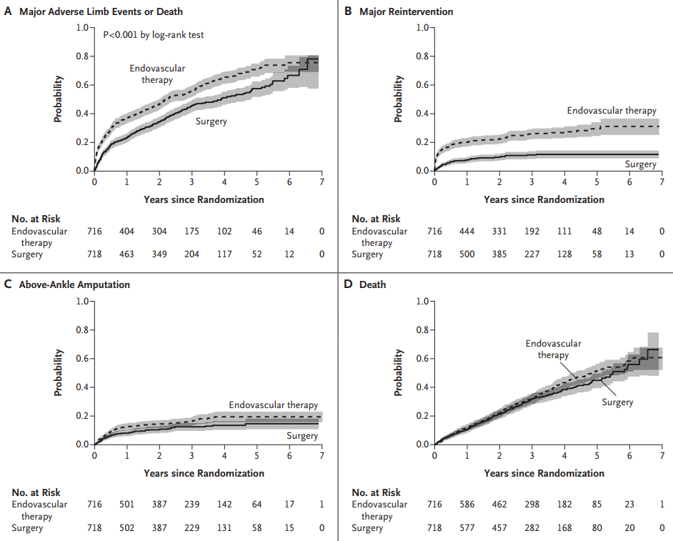
BEST-CLI Cohort 1
MALE primary outcomes
MALE
Surgery: 302 of 709 patients (42.6%)
ER: 408 of 711 patients (57.4%)
Hazard ratio, 0.68; 95% CI, 0.59 to 0.79; P<0.001
Major reinterventions
Surgery: 65 of 709 patients (9.2%)
ER: 167 of 711 patients (23.5%)
Hazard ratio, 0.35; 95% CI, 0.27 to 0.47)
Above-ankle amputation of the index limb
Surgery: 74 of 709 patients (10.4%)
ER: 106 of 711 patients (14.9%)
Hazard ratio, 0.73; 95% CI, 0.54 to 0.98
The incidences of death from any cause and perioperative death were similar in the two groups
The median length of hospital stay was longer in the surgical group than in the endovascular group (6 days vs. 3 days)
Farber, NEJM, 2022

Slide 35
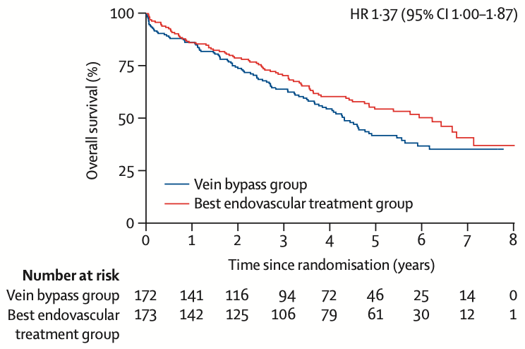
BASIL 2 RCT: Amputation and Survival
Bypass vs Angioplasty in Severe Ischaemia of the Leg (BASIL) trial
91 (53%) of 172 patients in the vein bypass group and 77 (45%) of 173 in the best endovascular treatment group died from any cause (adjusted HR for overall survival 1·37 [95% CI 1·00–1·87; figure 3)
35 (20%) of 172 in the vein bypass group and 32 (18%) of 173 patients in the best endovascular treatment group had a major amputation (adjusted HR 1·23 [95% CI 0·75–2·01]).
Bradbury, Lacet, 2023

Slide 36
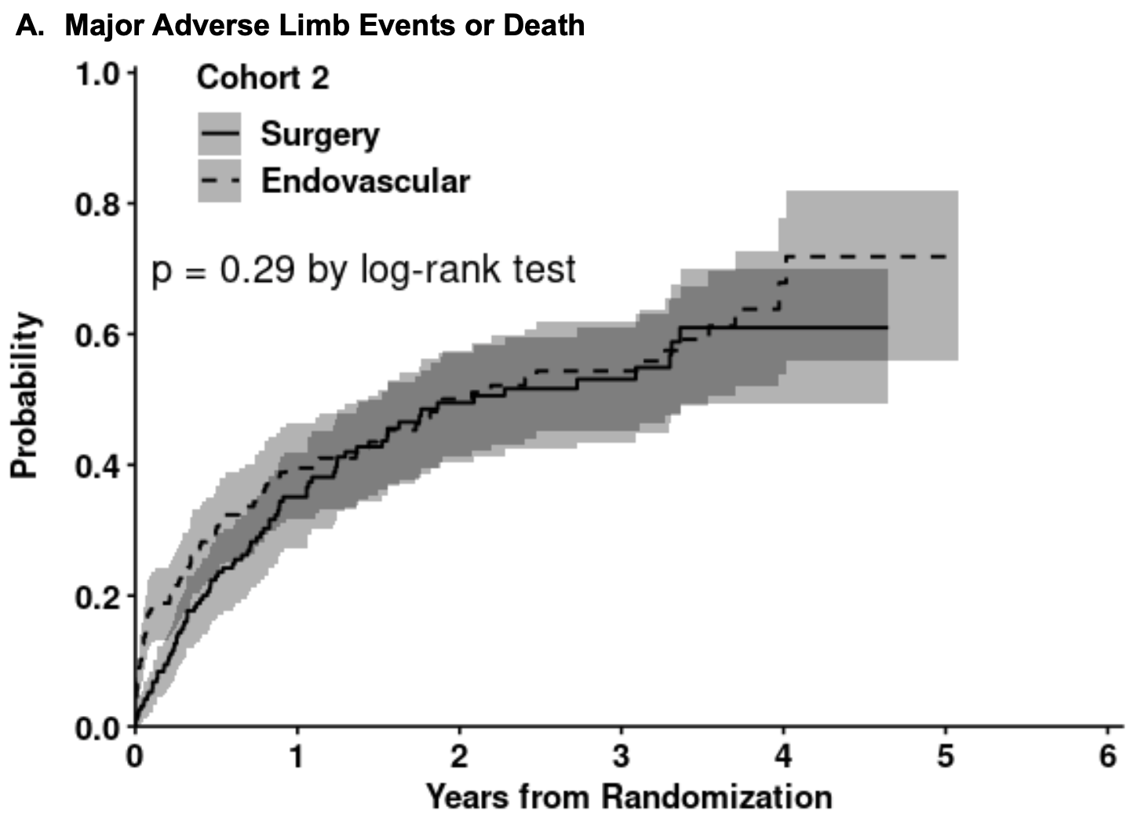
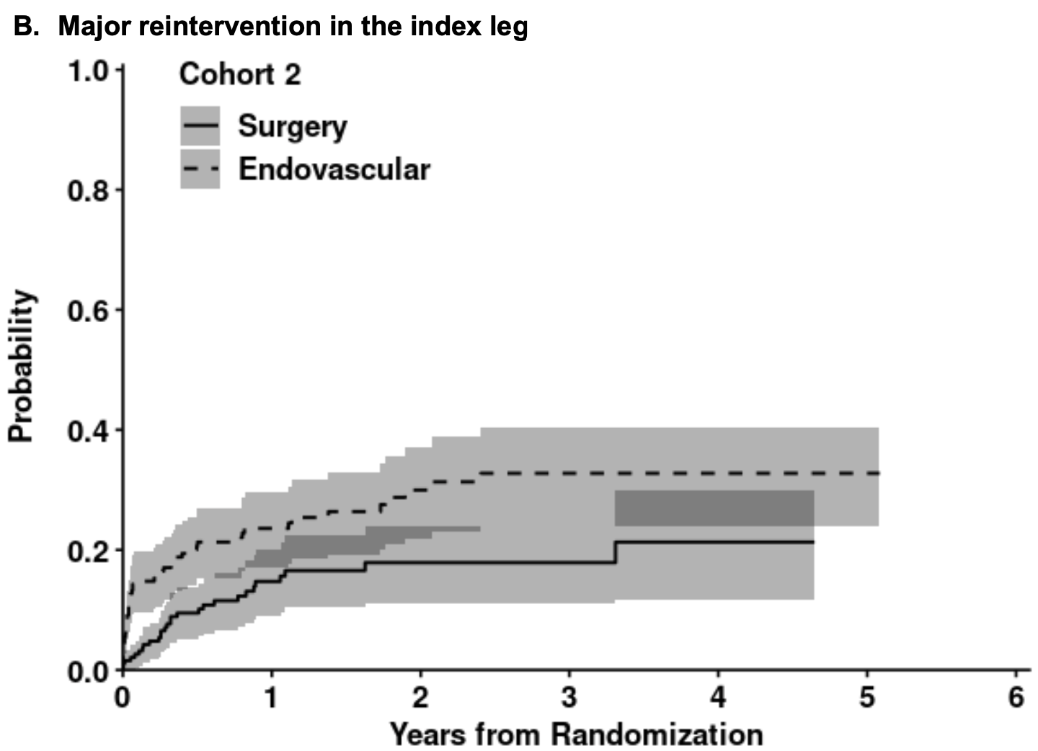


BEST-CLI Cohort 2
Primary outcomes
MALE
Surgery: 83 of 194 patients (42.8%)
ER: 95 of 199 patients (47.7%)
hazard ratio, 0.79; 95% CI, 0.58 to 1.06; P = 0.12
Major reinterventions
Surgery: 28 of 197 patients (14.2%)
ER: 51 of 199 patients (25.6%)
Hazard ratio, 0.47; 95% CI, 0.29 to 0.76
Above-ankle amputation of the index limb
Surgery: 30 of 97 patients (15.2%)
ER: 28 of 199 patients (14.1%)
Hazard ratio, 1.10; 95% CI, 0.65 to 1.87
The incidences of death from any cause and perioperative death were similar in the two groups
The median length of hospital stay was longer in the surgical group than in the endovascular group (6.4 days vs. 5.4 days)
Farber, NEJM, 2022

Slide 38

Evolution de la qualité de vie au fil du temps
Ajusté selon le quartile de qualité de vie à l’inclusion
WORST Baseline QoL BEST Baseline QoL
Quartile 1
Quartile 2
Quartile 3
Quartile 4
Overall
Baseline Rutherford Class
RC6 | RC5 | RC4
RC3 | RC2 | RC1
French Index Score
Notes:
This graph is a little complex, so I'll walk you through it. This looks at the quality of life change over time adjusted for the baseline quality of life. So here in the bottom you can see the 30 day, 12 months and 24 months data.
For each quartile of patients based on their baseline quality of life. So quartile one had the worst baseline quality of life, while quartile 4 had the best baseline quality of life. And what this is showing is that the quality of life improvements Were more profound in patients with the worst baseline. So those patients with the worst baseline quality of life had the greatest improvement, whereas those that started out already doing pretty good didn't really show a significant improvement here. And this is just because this isn't a ceiling effect In the data.
And you can see also with these little heat maps across the top that the disease severity in these patients, not surprisingly those with the worst baseline quality of life tended to be Rutherford five and six patients with critical limb ischemia. Whereas those with the best quality of life at baseline tended to be claudicant patients here. And the reason this is important is because we've seen recently, if you've heard of the SWEDEPAD study, some studies showing no benefit in terms of quality of life for DCB.
Yet they enrolled primarily claudicants in their cohort. So the point of this slide is to show that the improvement in quality of life is dependent on the disease severity and how sick your patients are at baseline.

Slide 39




What About Complex Femoropopliteal Lesions ?
Defined as ≥ 15-cm / TASC C/D
Reijnen. JACC 2017; Bosiers J Endovasc Surg 2020; Enzmann JACC 2019
Defined as severe calcifications
Fanelli F, et al. Cardiovasc Intervent Radiol. 2014
≥ 15-cm

Slide 40
SPORTs
Study Design
Principal Investigator | Gunnar Tepe, MD RoMed Klinikum, Germany
Design | Prospective, randomized (1:1:1), open-label, multicenter
Objective | Compare angiographic and clinical outcomes of TASC C/D lesions in the SFA after treatment with DES (EluviaTM Drug Eluting Vascular Stent System, Boston Scientific), DCB (SeQuent PleaseTM OTW, BBraun), or BNS (bare nitinol stent, any commercially available)
Primary Endpoint | Angiographic diameter stenosis at 12 months (core lab) Hypothesis: Superiority of DES over BNS Noninferiority of DCB versus BNS
Patients | N=224 Key inclusion criteria: Rutherford classes 2-4 Lesion length at least 13 cm (treatment length at least 15 cm) Lesions in the SFA and/or proximal popliteal artery Diameter stenosis ≥70%
Enrolled
N=224
DCB (SeQuent PleaseTM OTW)
N=74
BNS
N=76
DES (EluviaTM)
N=74
Tepe G, TCT 2023.
All trademarks are the property of their respective owners. Rx Only. This investigator-sponsored study is supported by grant funding from Boston Scientific. Boston Scientific is not responsible for the collection, analysis or reporting of these studies which remain the sole responsibility of the investigators. Sequent Please not available for sale in the United States.

Slide 41


Primary Patency @ 2 years
SPORTs @ 2 years
Freedom from CD-TLR @ 2 years
PES
PES
PCB
PCB
BNS
BNS
Calculated by Kaplan-Meier curve time to loss of primary patency defined as ultrasound-derived peak systolic velocity ratio of <2.4 or TLR
Calculated by Kaplan Meier curve. Patients with non-CD-TLR are refrained from analysis after TLR but without counting for CD-TLR
¶ Log-rank test for difference of treatment groups.

Slide 42
Treatment of Long Femoropopliteal Lesions for CLTI is Frequent

Slide 43
BASIL 3 RCT
To determine which primary endovascular revascularisation strategy represents the most clinically e!ective treatment for patients with CLTI who require endovascular femoro-popliteal, with or without infra-popliteal, revascularisation (POBA, DCB, DES)
The median time to last clinical follow-up was 2.1 years (range 0-7.2 years)
Major amputation or death occurred in
106 of 160 (66%) participants in the POBA±BMS group
97 of 161 (60%) in the DCB±BMS group,
93 of 159 (58%) in the DES group
Adjusted hazard ratios: PBA±BMS v DCBA±BMS: 0.84, 97.5% confidence interval 0.61 to 1.16, P=0.22; PBA±BMS v DES: 0.83, 0.60 to 1.15, P=0.20.
Bradbury, BMJ, 2025
Notes:
Amputation free survival (AFS) Kaplan-Meier plot and hazard ratio over time fitted assuming non-proportional hazards (intention-to-treat analysis). CI=confidence interval

Slide 44
Freedom from in-stent restenosis* @ 12 months (primary endpoint) (Kaplan Meier estimates)
@ 12 months:
MISAGO®: 85.7%
ZILVER® PTX®: 90.3%
P=0.36
@ 24 months:
MISAGO®: 80.9%
ZILVER® PTX®: 85.8%
P=0.64
*Defined by restenosis of >50% and by a peak systolic velocity index >2.4 at the target lesion. Assessment by an independent core laboratory (thromboses were excluded)

Slide 45
BATTLE flow chart
186 were included - 5 not randomized
(from February 2014 to September 2018)
181 underwent randomization
MISAGO (91)
84 underwent assigned intervention
ZILVER PTX (90)
85 underwent assigned intervention
80 completed
12-month follow-up
83 completed
12-month follow-up
68 completed
24-month follow-up
76 completed
24-month follow-up
*ITTm: modified intention-to-treat analysis on the primary endpoint was performed to include only patients who had undergone randomization and met the major inclusion criteria.
**6 patients were lost of FU at 1-year.

Slide 46
EMINENT Effectiveness │ Primary Patency
Primary Endpoint
Statistically significantly greater primary patency in patients treated with Eluvia DES vs BMS 83.2% [337/405] vs 74.3% [165/222]; p=0.0077
p=0.0077
8.9%
(95%CI 2.1%, 15.7%)
Superior primary patency for Eluvia DES vs BMS
Eluvia DES
BMS
Intention to treat. Primary patency defined as core-lab assessed duplex ultrasound peak systolic velocity ratio (PSVR) ≤ 2.4 at 12 months in the absence of clinically-driven TLR or bypass of the target lesion.

Slide 47

Zilver PTX RCT
Zilver PTX vs POBA for TASC A/B femoropopliteal lesions
At 5 years, sustained clinical, morphological and hemodynamic outcomes
Dake, Circulation, 2016
Dake, Circulation, 2016

Slide 48





Drug Eluting Devices
Drug coated stents – Drug coated balloons
PLATFORM
Drug carrier
DRUG
DES
DCB

Slide 49


Clinical Benefit – Major Amputation – Reintervention
Restenosis
Recoil- Intimal hyperplasia- Constrictive remodeling
Bittl. N Engl J Med 1996

Slide 50
No Class effect Between DES and DCB
Primary Patency @ 2 years
Freedom from CD-TLR @ 2 years
PES
PES
PCB
PCB
BNS
BNS
Calculated by Kaplan-Meier curve time to loss of primary patency defined as ultrasound-derived peak systolic velocity ratio of <2.4 or TLR
Calculated by Kaplan Meier curve. Patients with non-CD-TLR are refrained from analysis after TLR but without counting for CD-TLR
¶ Log-rank test for difference of treatment groups.

Slide 51


Lesion baseline characteristics
 | PCB n = 74 | PES n = 74 | BNS n = 76 | P value
Lesion length, mm, mean ± SD$1$ | 221 ± 87 (n=73) | 235 ± 78 (n=73) | 227 ± 78 (n=75) | 0.57
Occlusion, n (%) $1$ | 52 (70) | 63 (85) | 56 (74) | 0.08
Occlusion length, mm, mean ± SD$1$ | 175 ± 91 (n=51) | 179 ± 89 (n=62) | 151 ± 81 (n=54) | 0.18
RVD, mm, mean ± SD$1$ | 5.0 ± 0.6 | 5.3 ± 0.7 | 5.2 ± 0.7 (n=75) | 0.01
MLD in lesion, mm, mean ± SD$1$ | 0.4 ± 0.7 | 0.2 ± 0.6 | 0.3 ± 0.7 | 0.18
Diameter stenosis in lesion, %, mean ± SD$1$ | 92.6 ± 13.2 | 96.8 ± 9.7 | 94.2 ± 11.7 | 0.10
Pre-dilation (%)² | 91 | 95 | 90 | 0.50
Bail out stenting (%)² | 58 | NA | NA | NA
Treated length, mm (mean±SD)¹ | 269 ± 82 (n=73) | 273 ± 80 (n=73) | 257 ± 68 (n=74) | 0.42
Post-procedural MLD in lesion, mm (mean±SD)¹ | 3.5 ± 0.7 (n=73) | 4.2 ± 0.7 | 4.1 ± 0.7 (n=74) | <0.0001
Post-procedural diameter stenosis, % (mean±SD)¹ | 30 ± 12 (n=73) | 20 ± 15 | 20 ± 14 (n=74) | <0.0001
¹ Corelab analysis; ² CRF data; NA = not applicable

Slide 52
Devices rates for Swedepad 1 and 2
Swedepad 1
Swedepad 2

